Slide 1
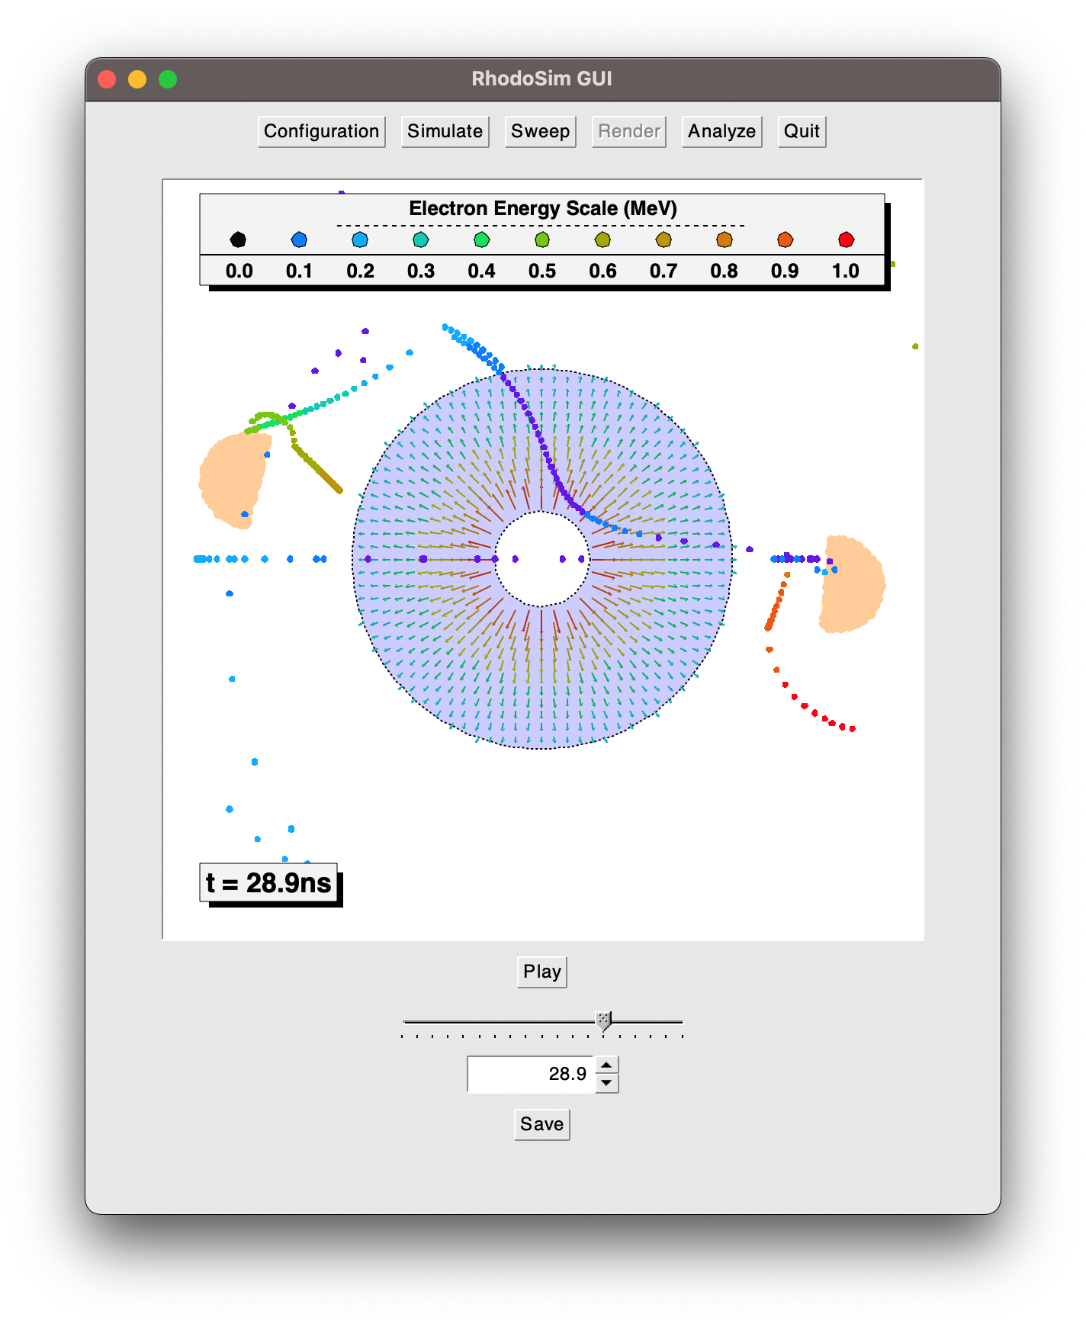
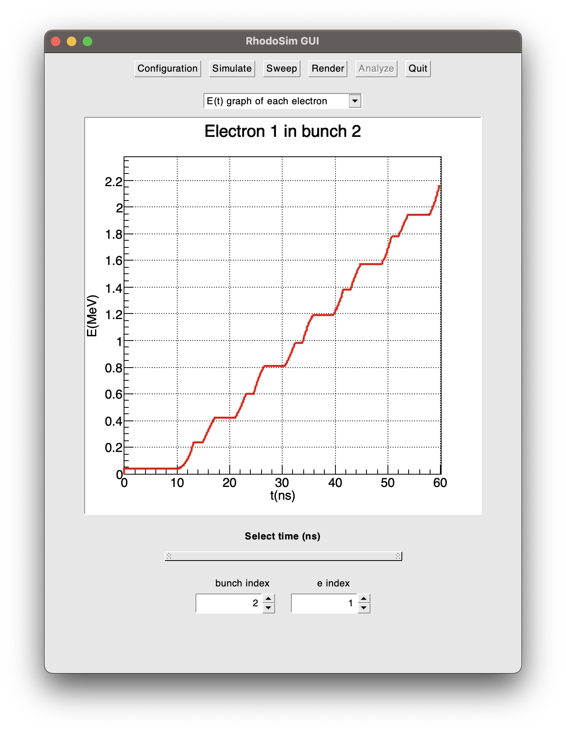
Rhodotron Simulation
An example workflow

Slide 2
Rhodotron Simulation Workflow
Manifacture a rhodotron cavity
Setup the RF power system
Manifacture an electron injection system (e-gun)
Phase lag sweep
When should the e-gun work?

Slide 3
Rhodotron Simulation Workflow Example
We have produced a cavity:
R1 = 0.188 m
R2 = 0.753 m
f = 107.5 MHz
Our e-gun produces and injects electrons:
Ein = 40 keV
tg = 1 ns
Tg = 1/f = 9.3 ns
φlag = ?
RF Power system forms a standing wave inside the cavity:
Emax(z=0) = 1.734 MV/m
f = 107.5 MHz

Slide 4
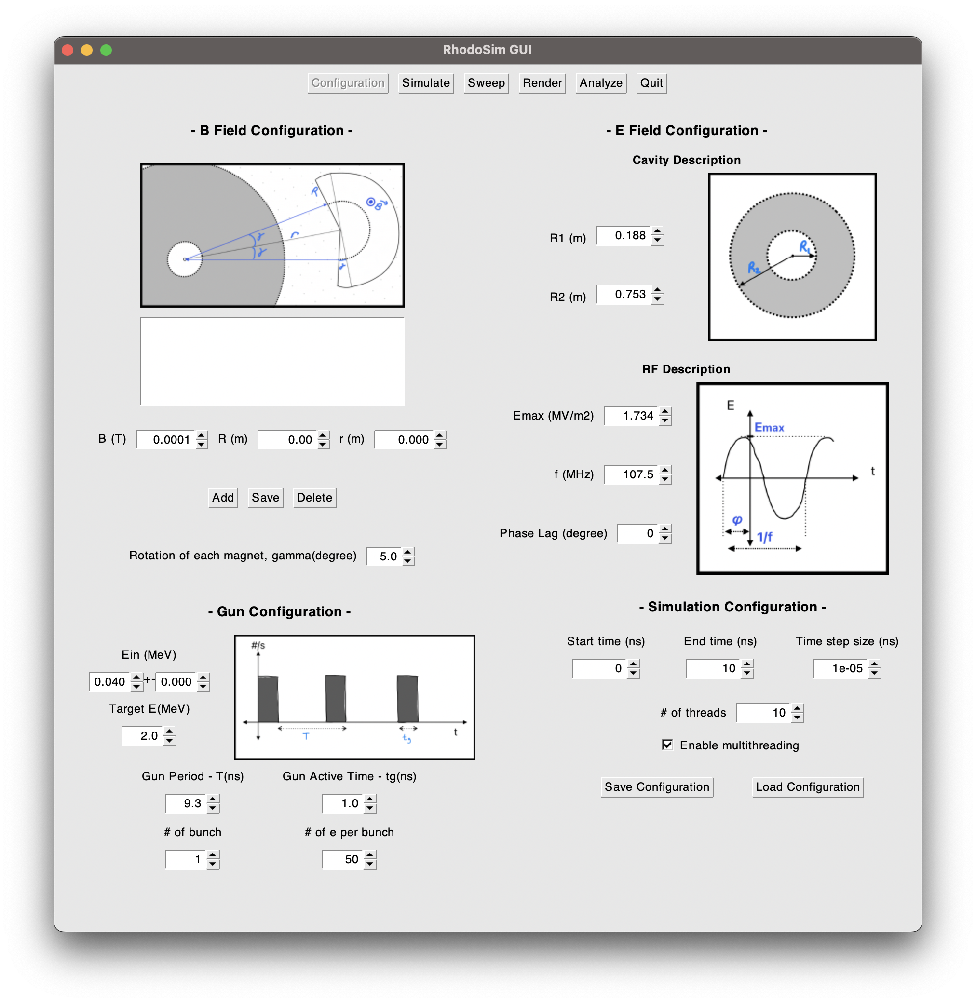
φlag Sweep Step 1:
Define the simulation configuration in Configuration Frame

Slide 5
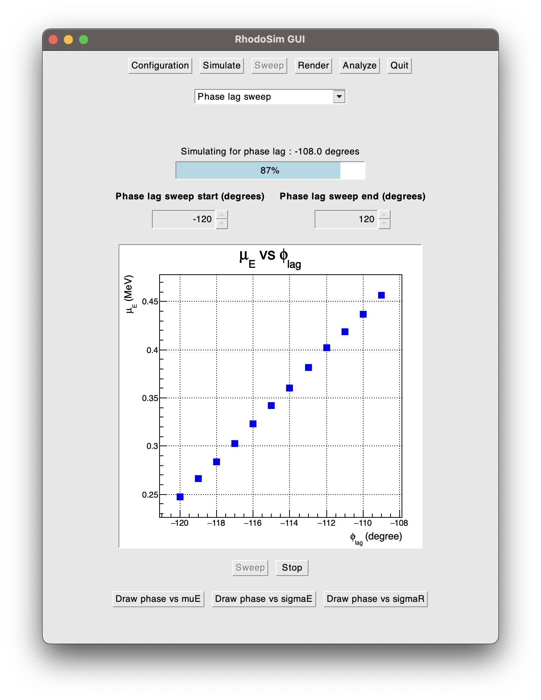
φlag Sweep Step 2:
Navigate to Sweep Frame, select φlag sweep and define the sweep interval. Start the sweeping process

Slide 6
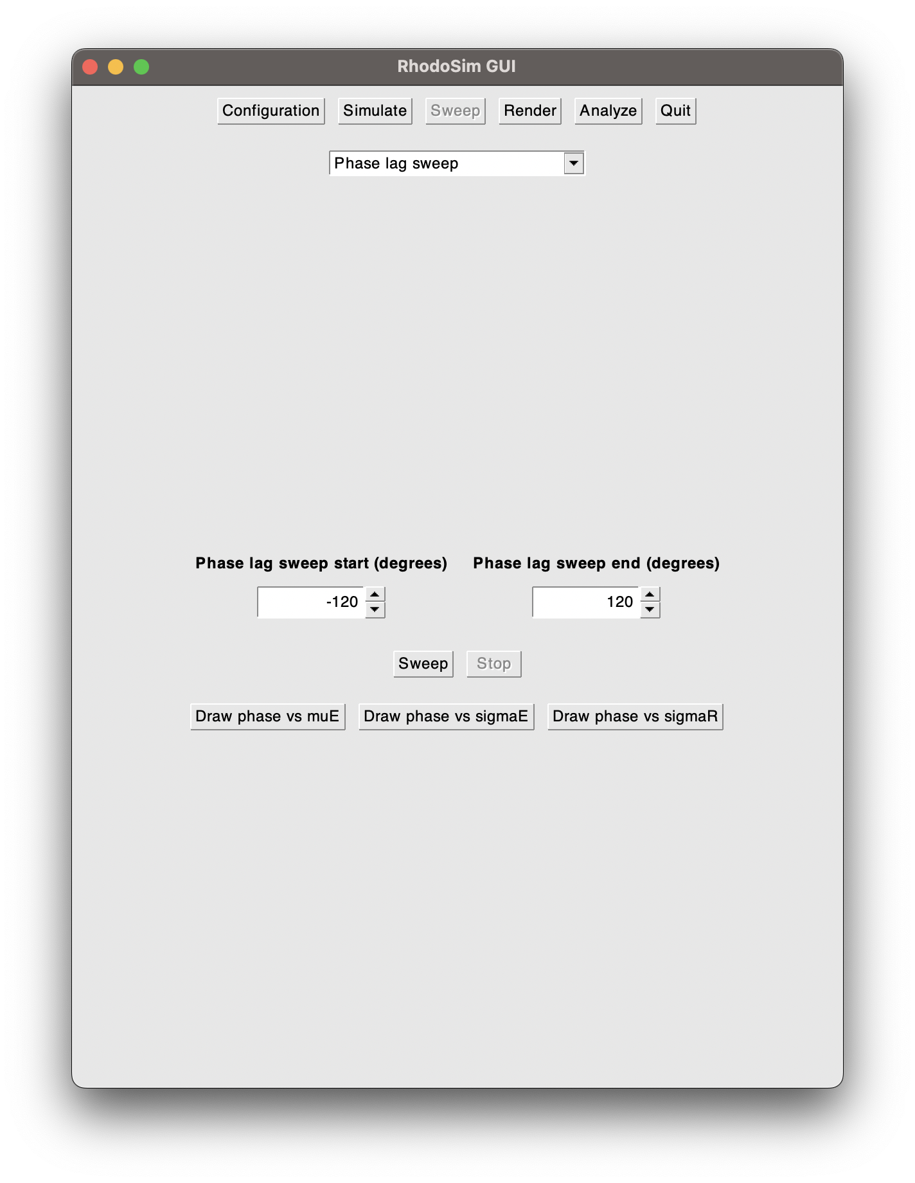
φlag Sweep Step 3:
When the sweeping finishes, analyze the
<E>, σE, σR graphs to find the optimum φlag of your configuration

Slide 7
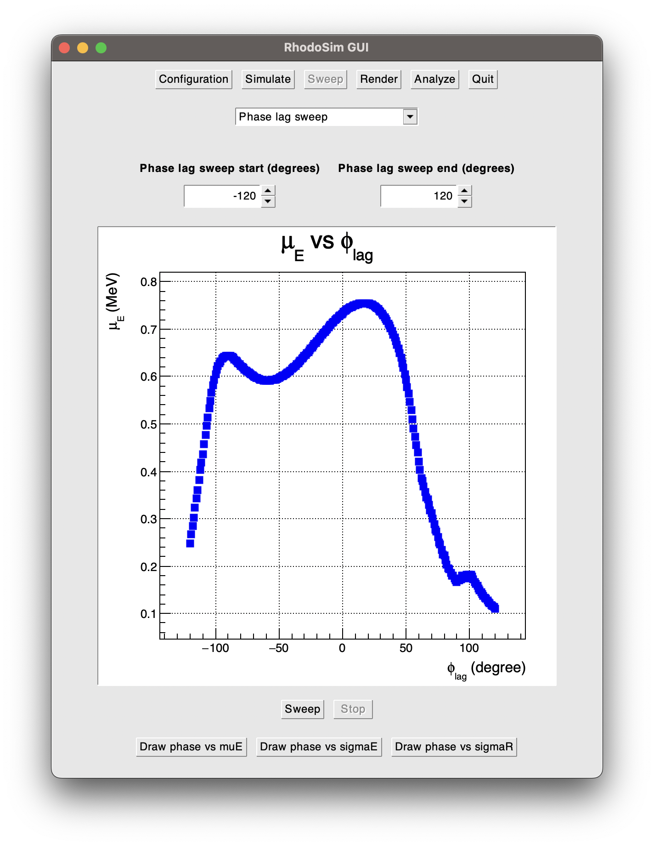
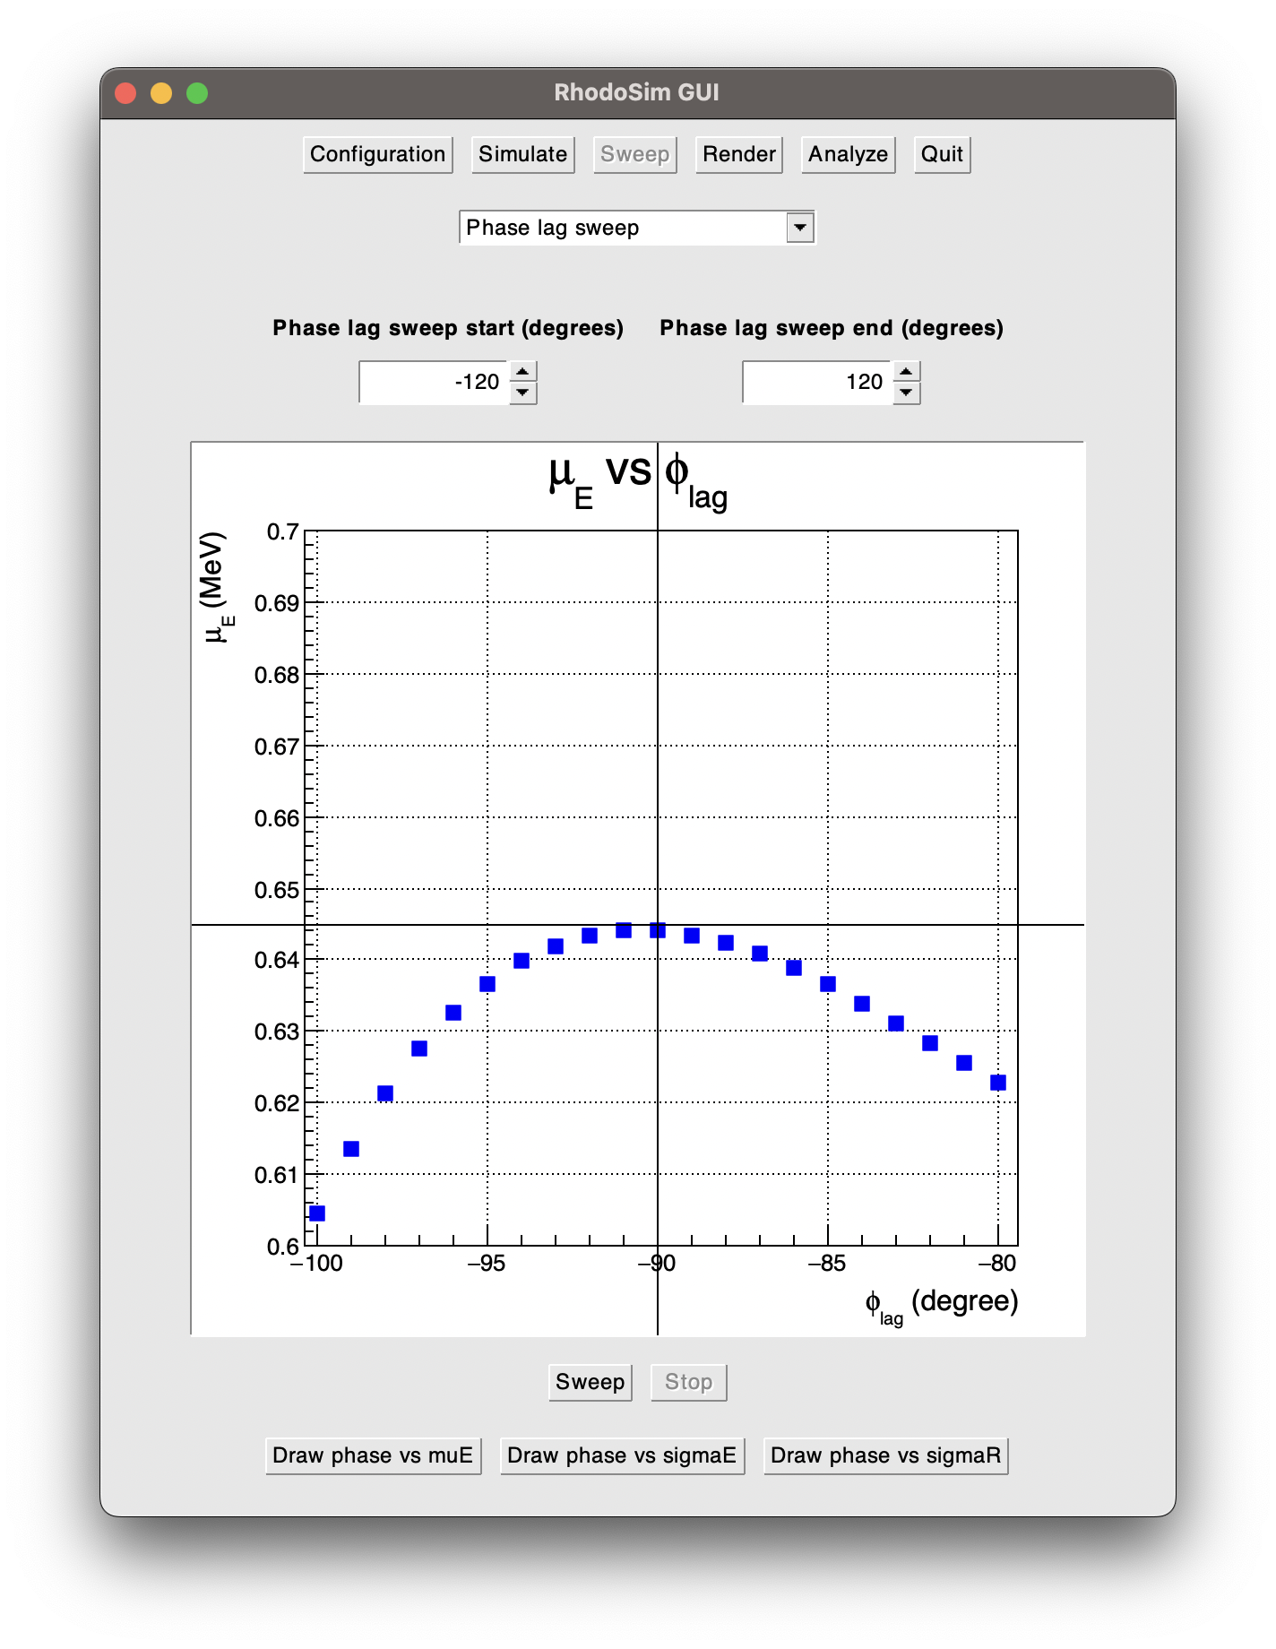
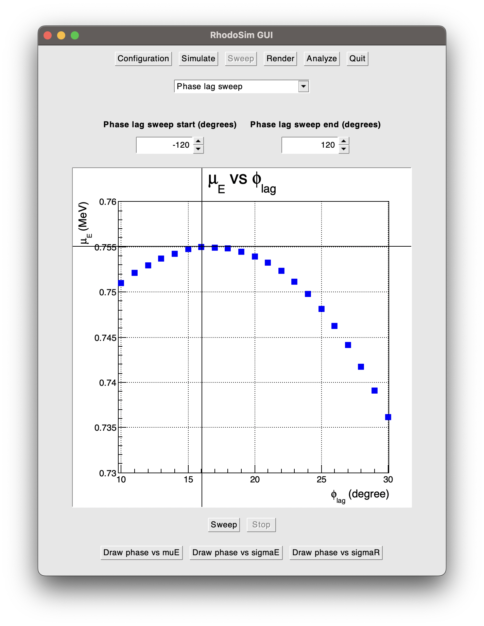
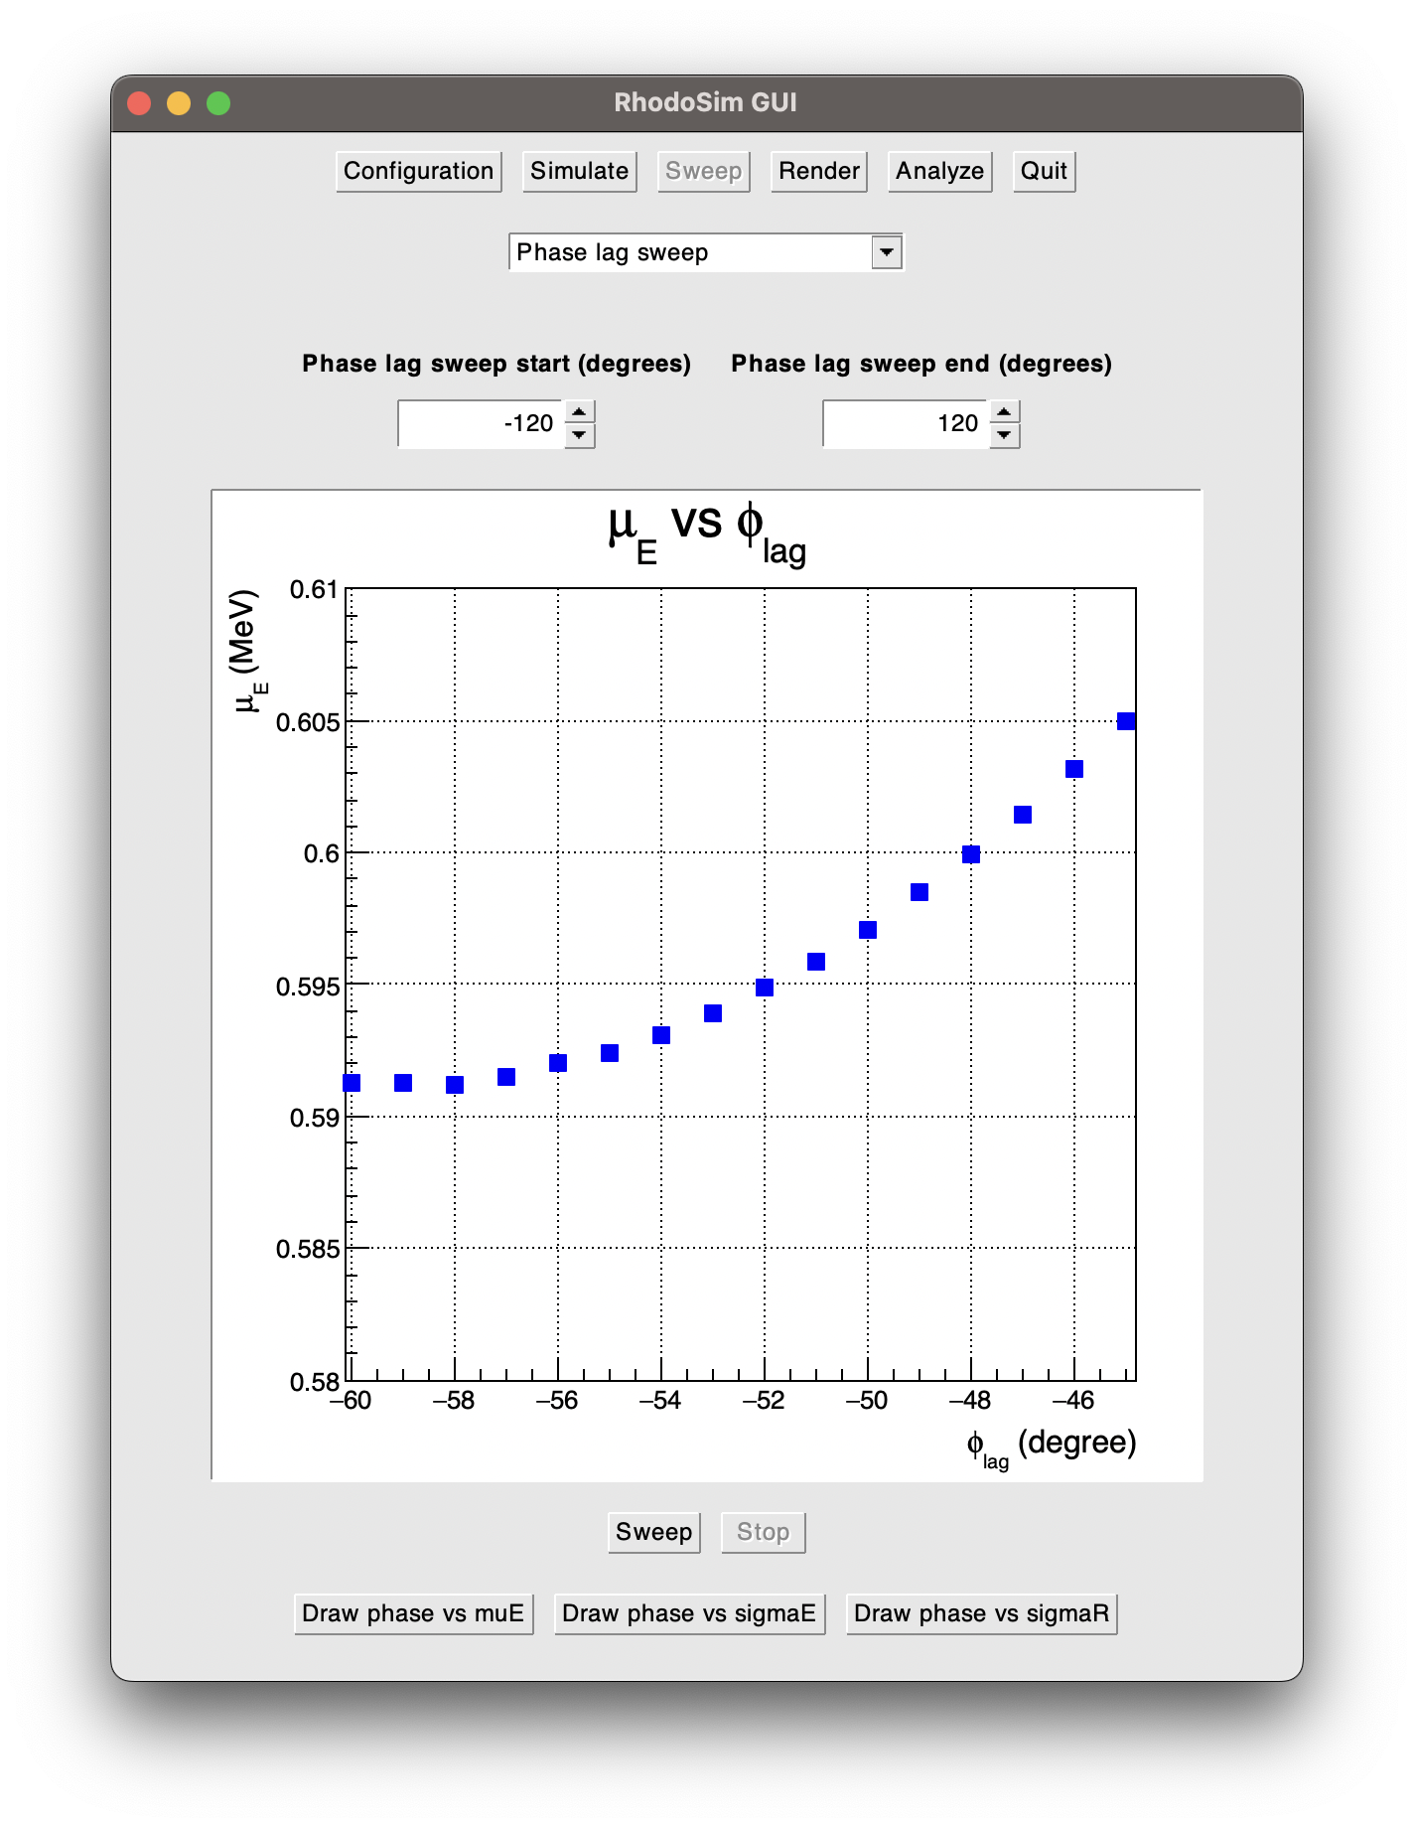
<E> vs φlag
Two peaks can be observed at
- φlag = -90°, <E> = 0.645 MeV
- φlag = 16°, <E> = 0.755 MeV
<E> > 0.7 MeV is achieved between around -10° < φlag < 40°

Slide 8
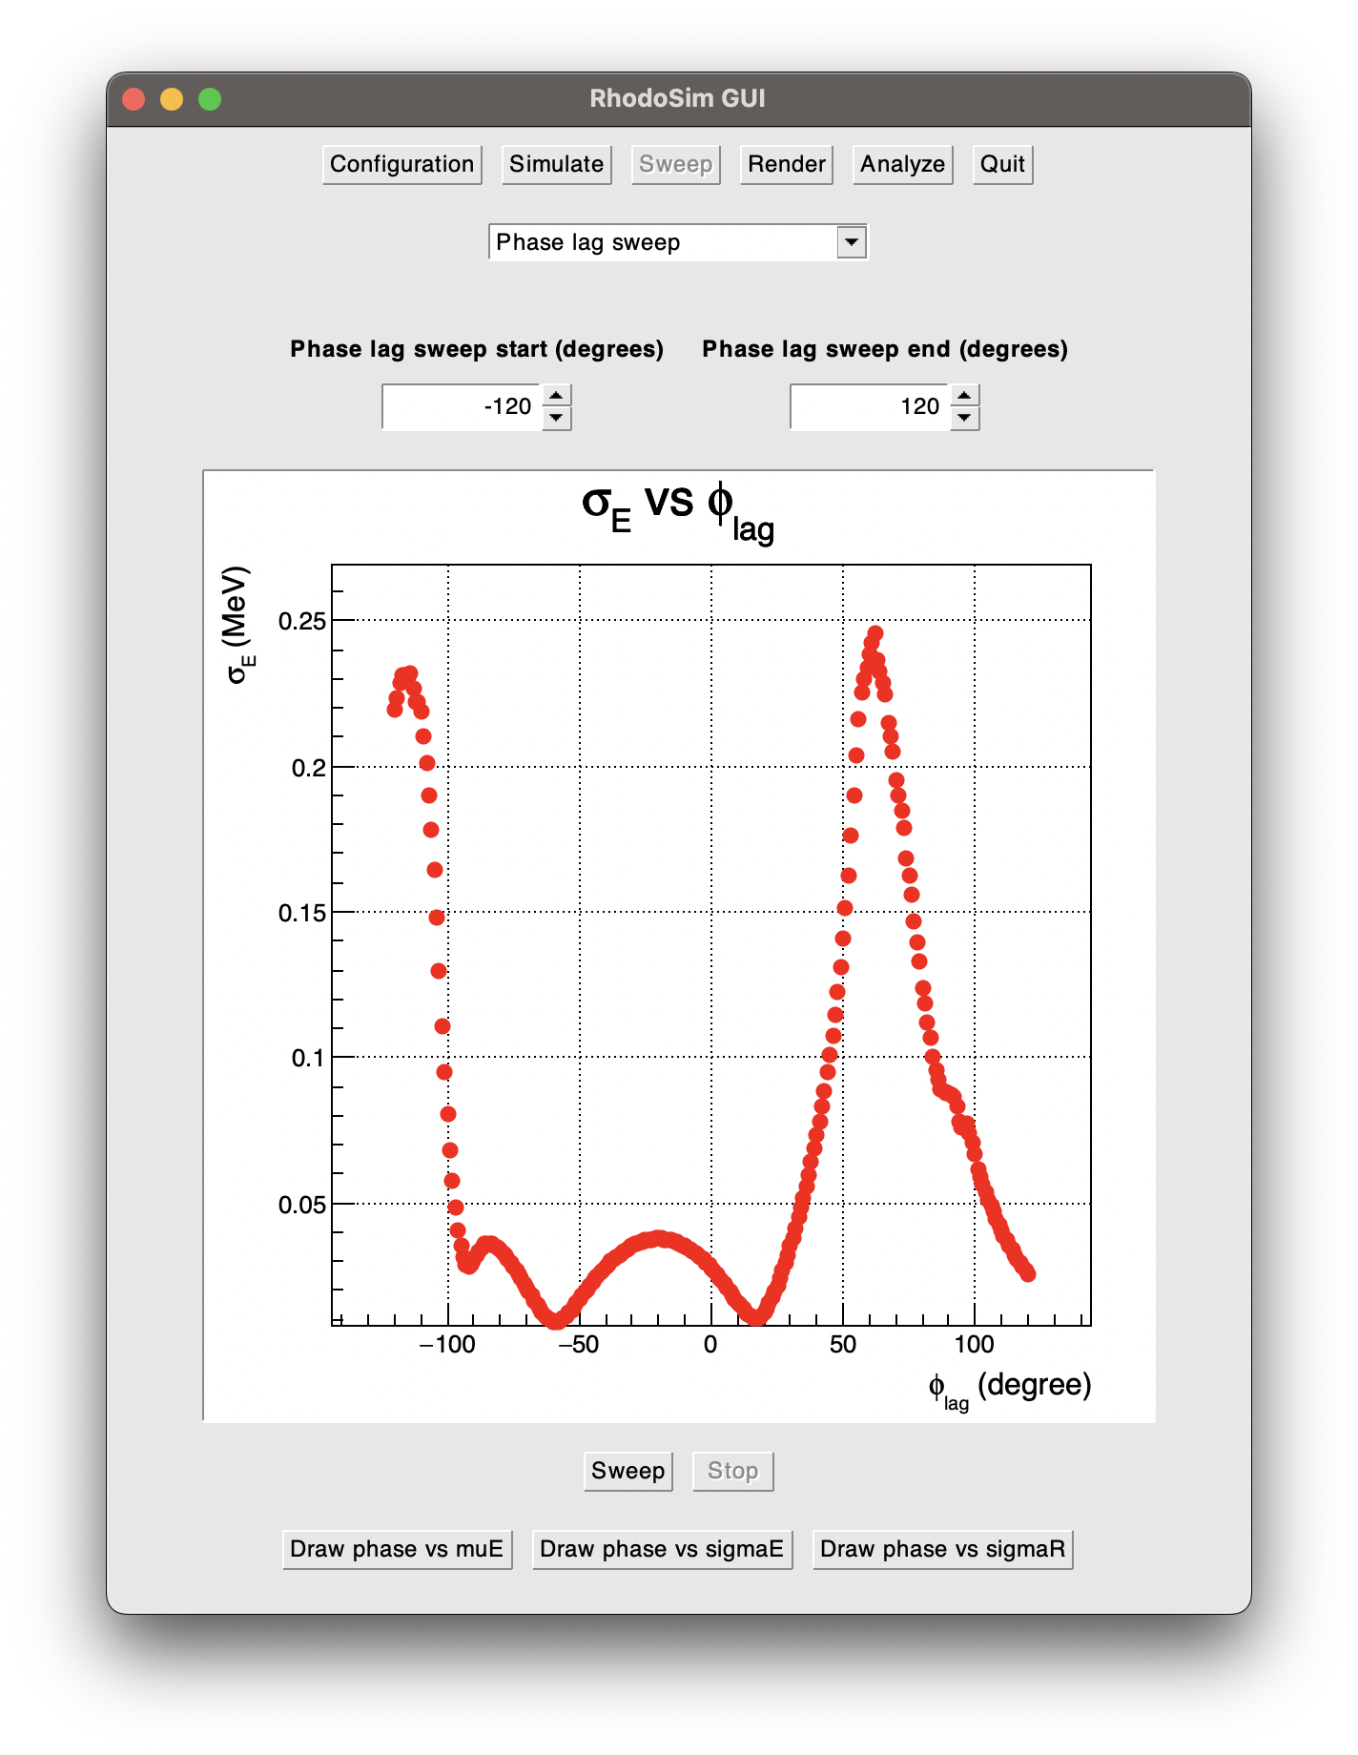
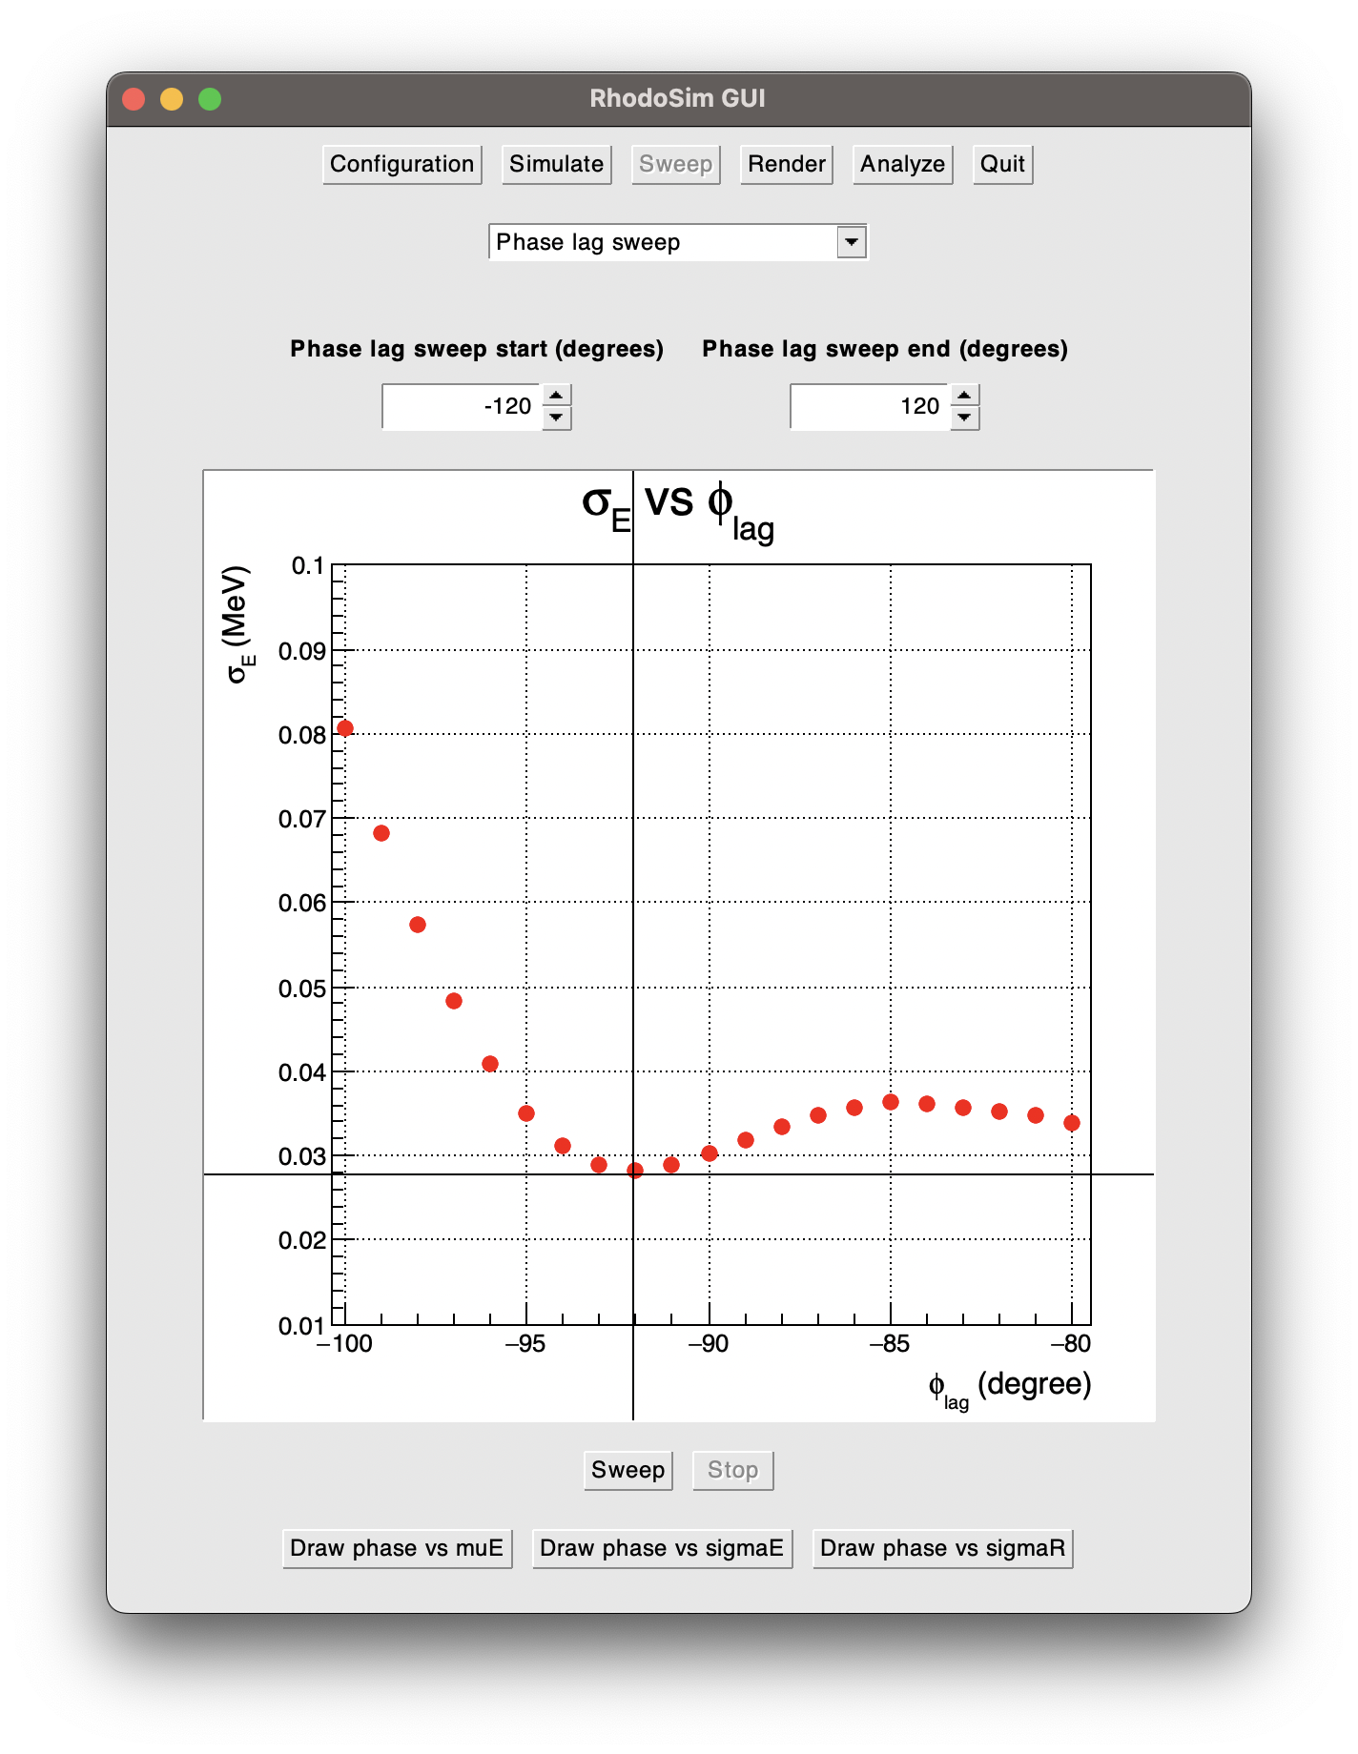
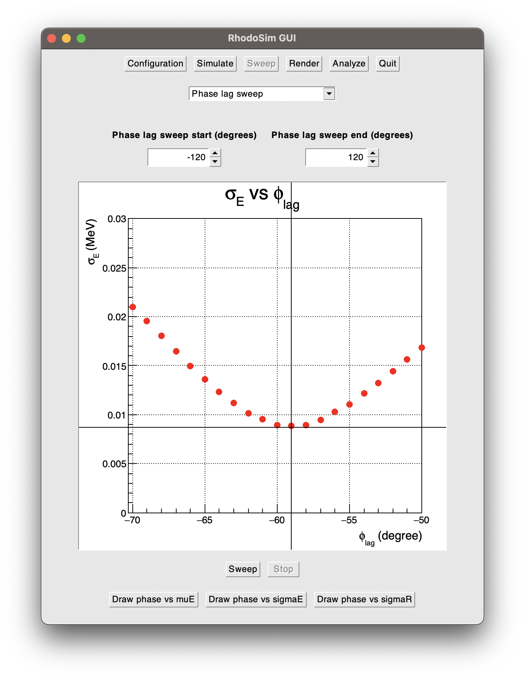
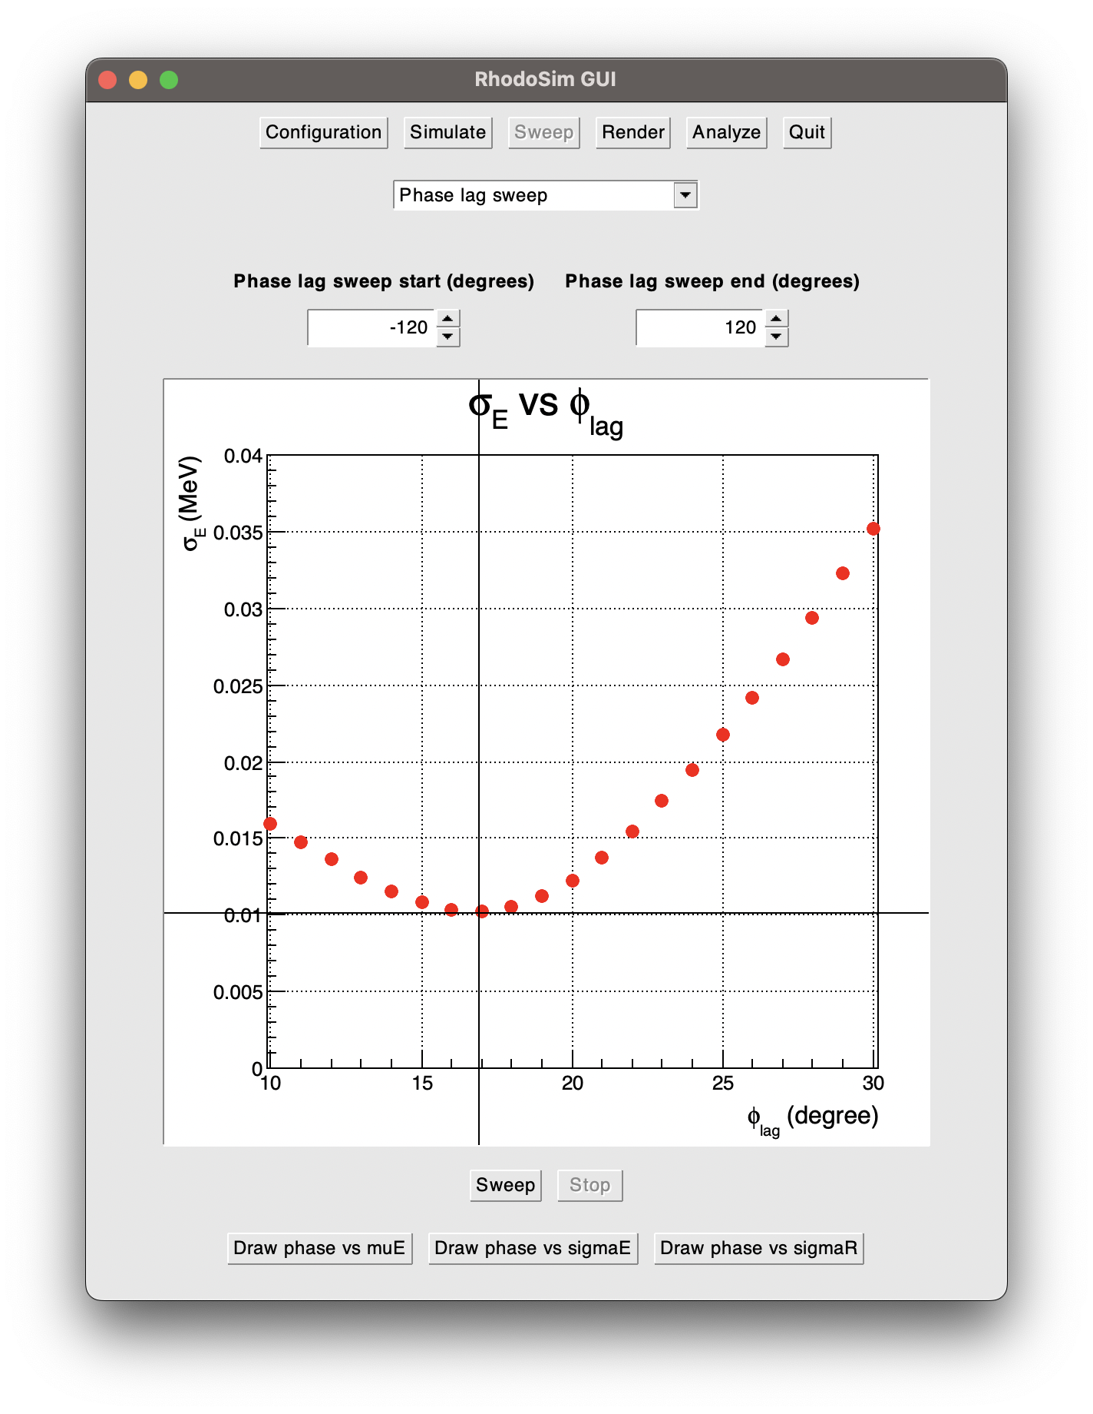
σE vs φlag
Three local minimums can be observed at
- φlag = -92°, σE = 0.028 MeV
- φlag = -59°, σE = 0.009 MeV
- φlag = 16° - 17° , σE = 0.01 MeV

Slide 9
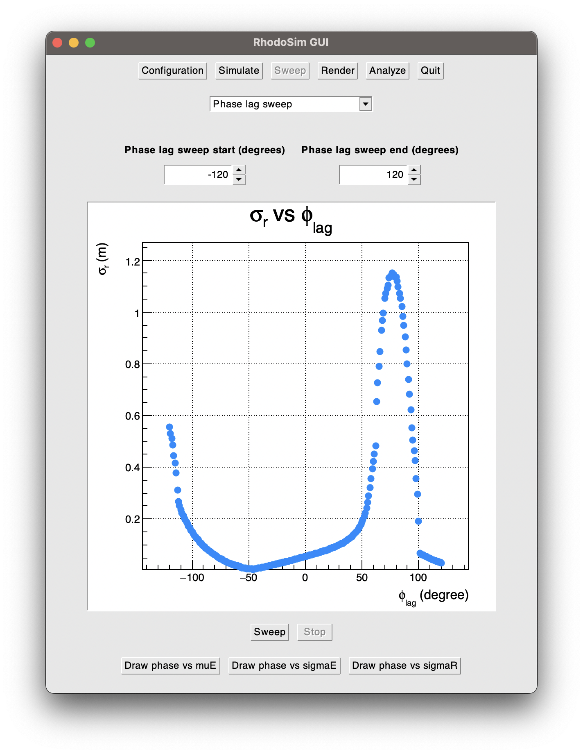
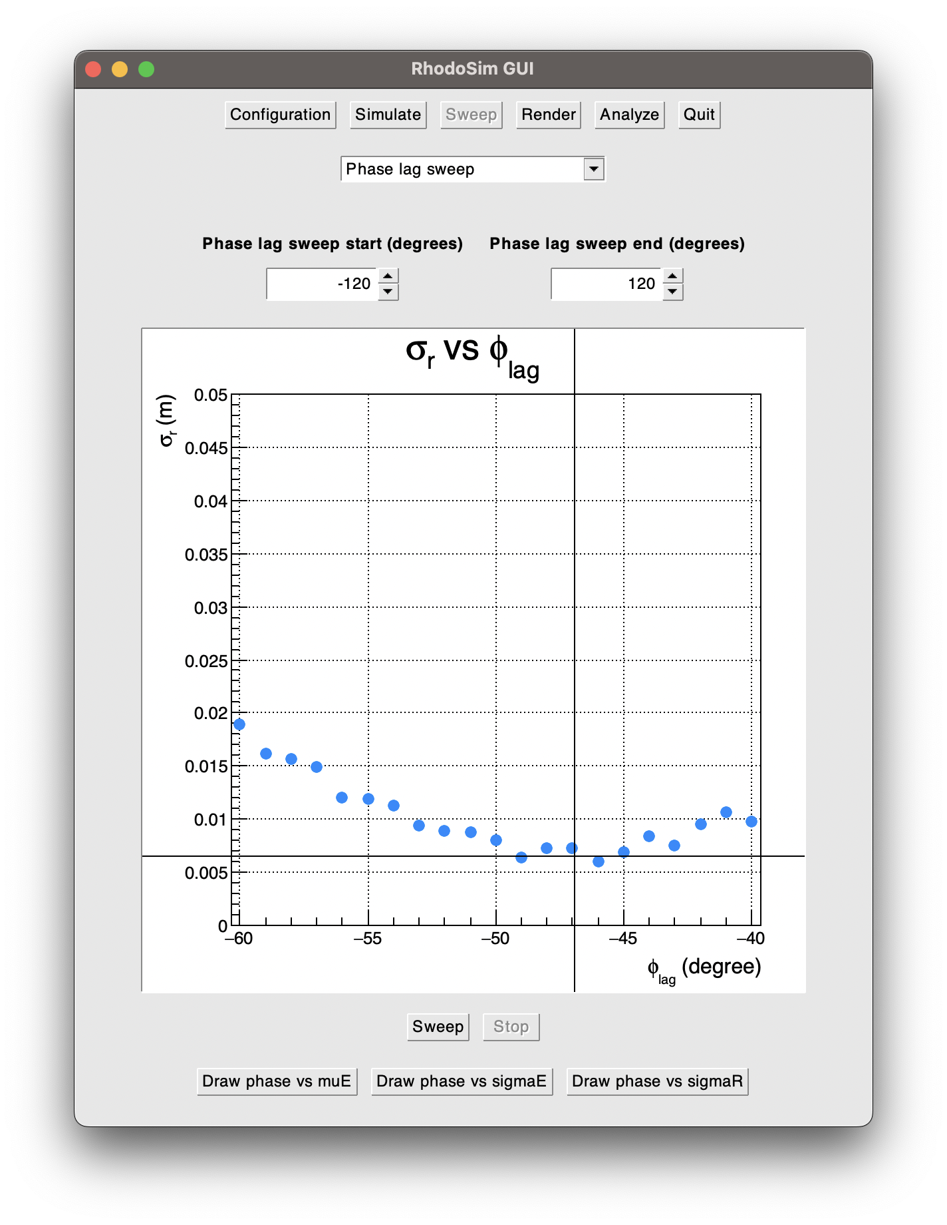
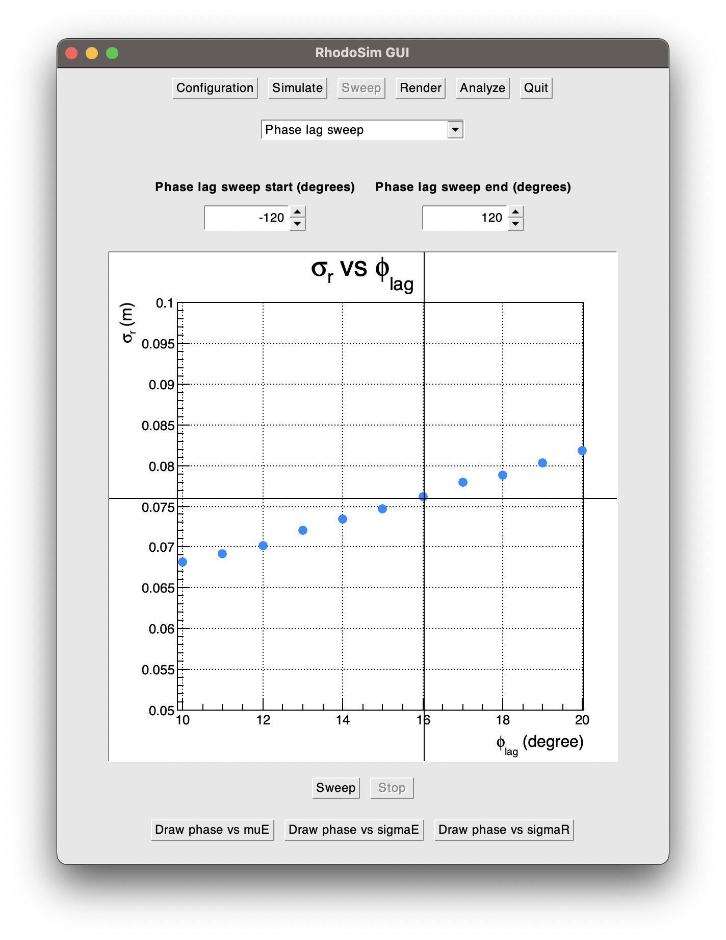
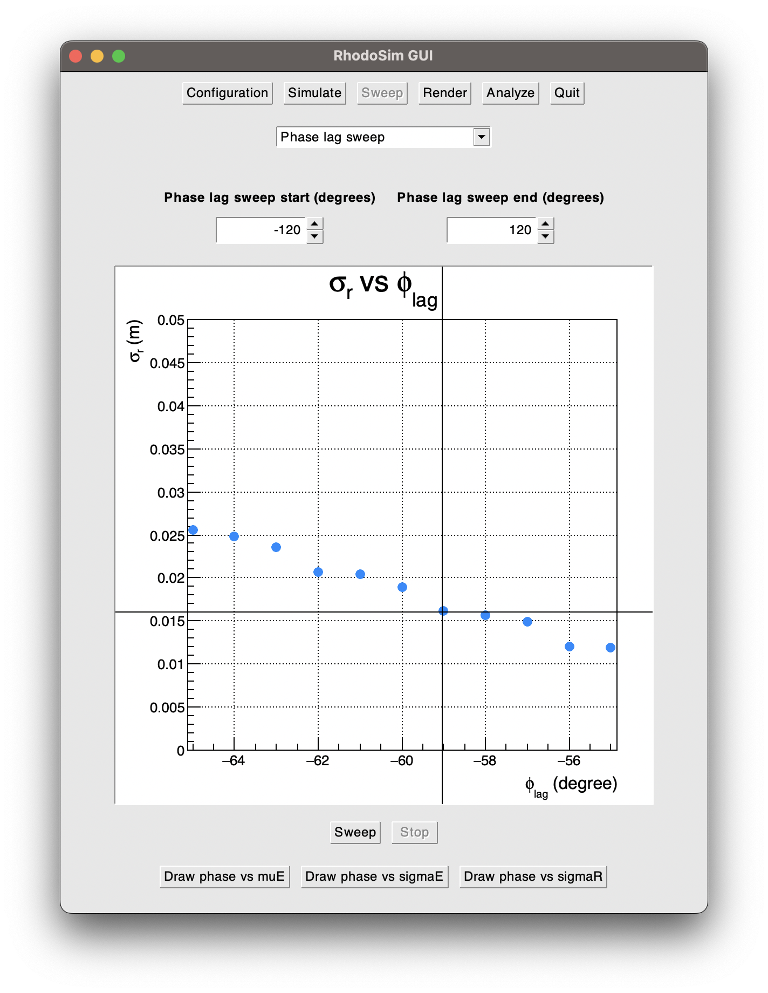
σR vs φlag
Minimum σR is at
-45° < φlag < -50°, σR ≈ 0.006 m

Slide 10
Optimum φlag
Three critical φlag values are :
φlag = 16° : E = 0.755 ± 0.01 MeV σR = 0.076 m
φlag ≈ -48° : E = 0.600 ± 0.019 MeV σR = 0.006 m
φlag = -59° : E = 0.591 ± 0.009 MeV σR = 0.016 m
For referance at the start of the simulation: E = 0.04 MeV σR = 0.03 m
Why does σE matter?
Large σE value results in deviation from the beamline inside the magnet in the next cycle, due to uneven turning radius
Increased particle losses if the beam is filtered when it exits the accelerator
Why does σR matter?
Large σR value results in uneven exposure to E field, resulting in loss of phase stability or larger σE in the next cycle
Increased particle losses

Slide 11
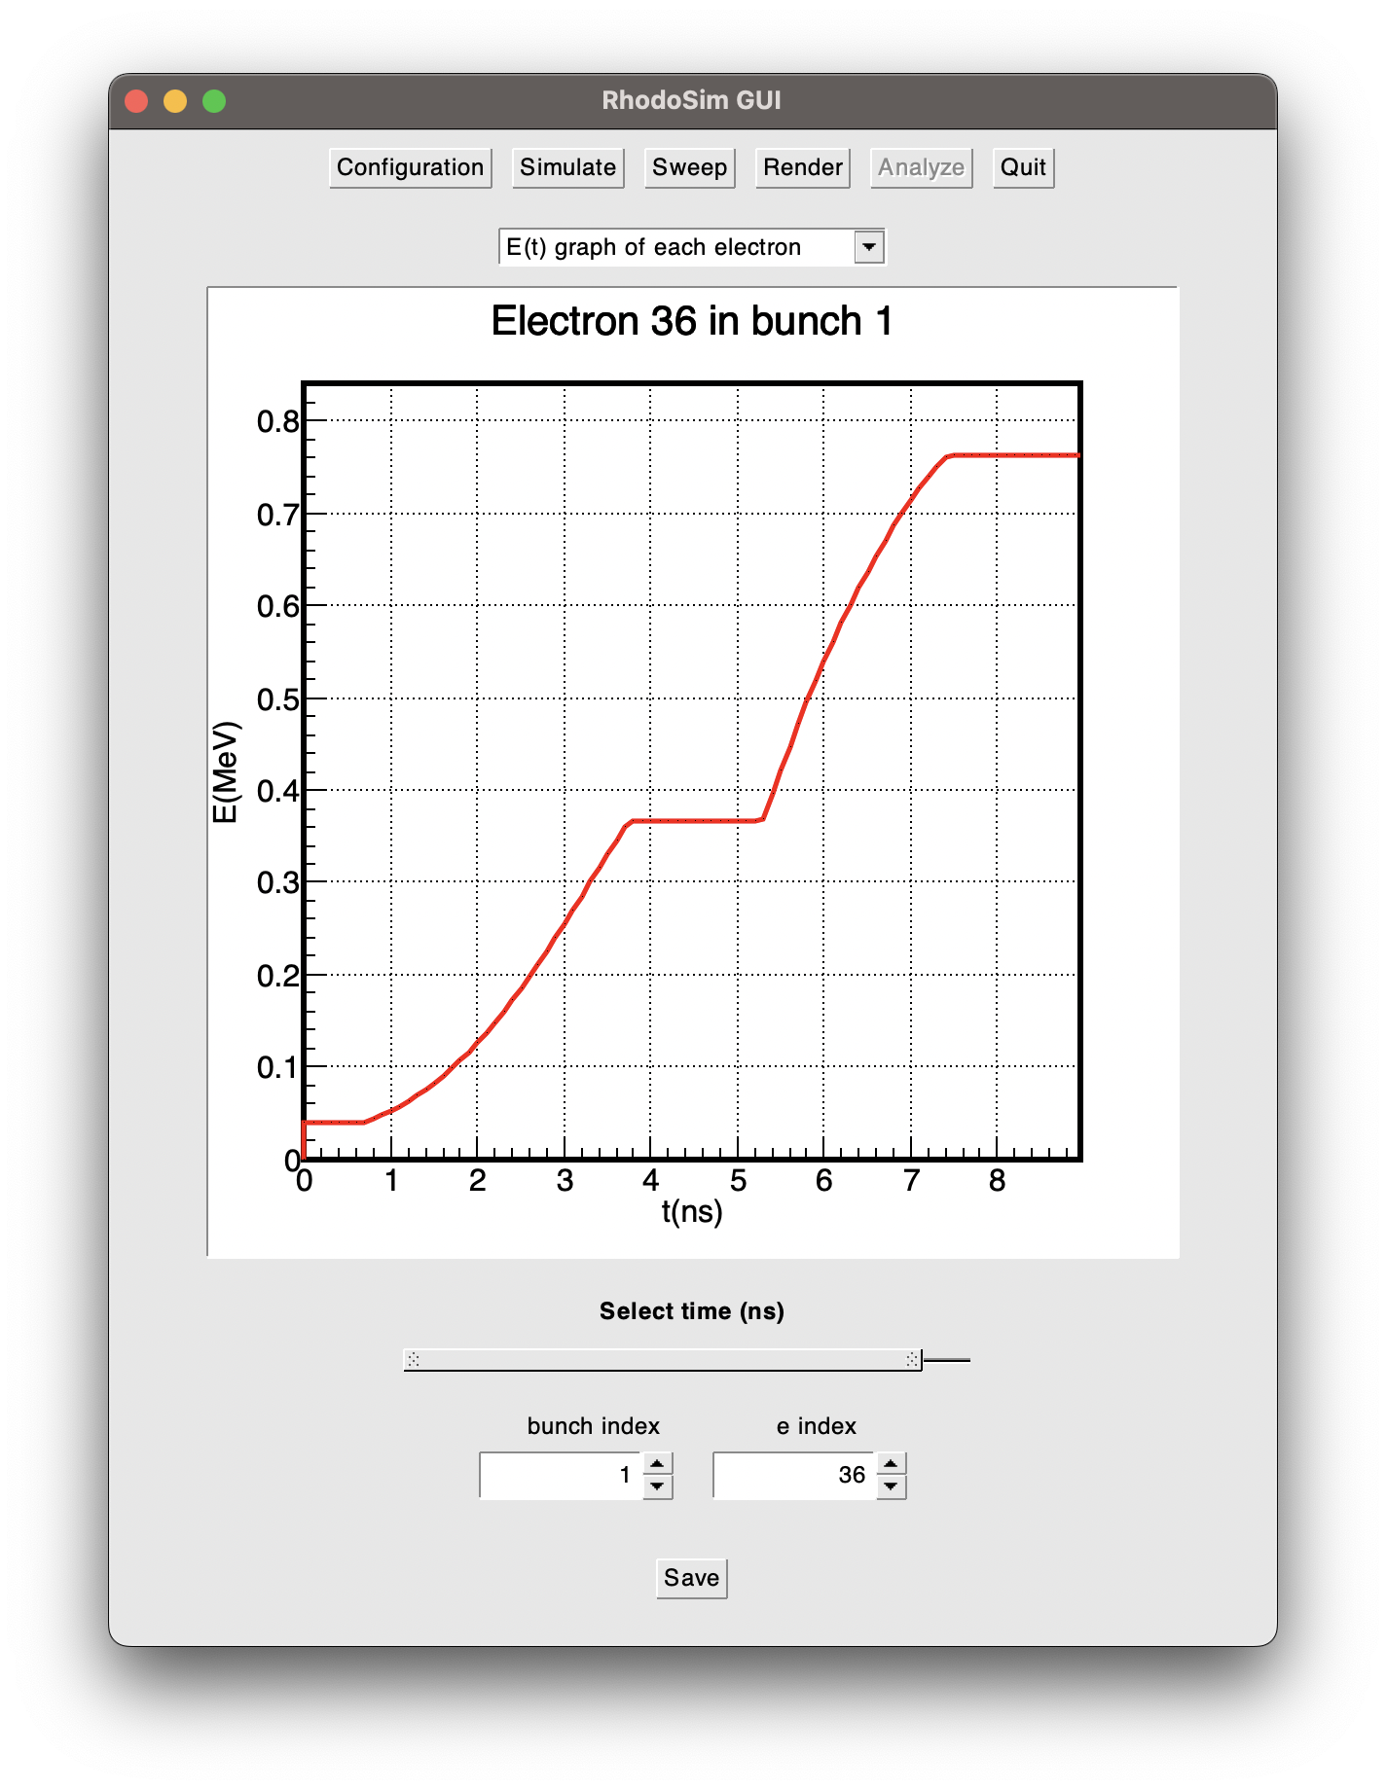
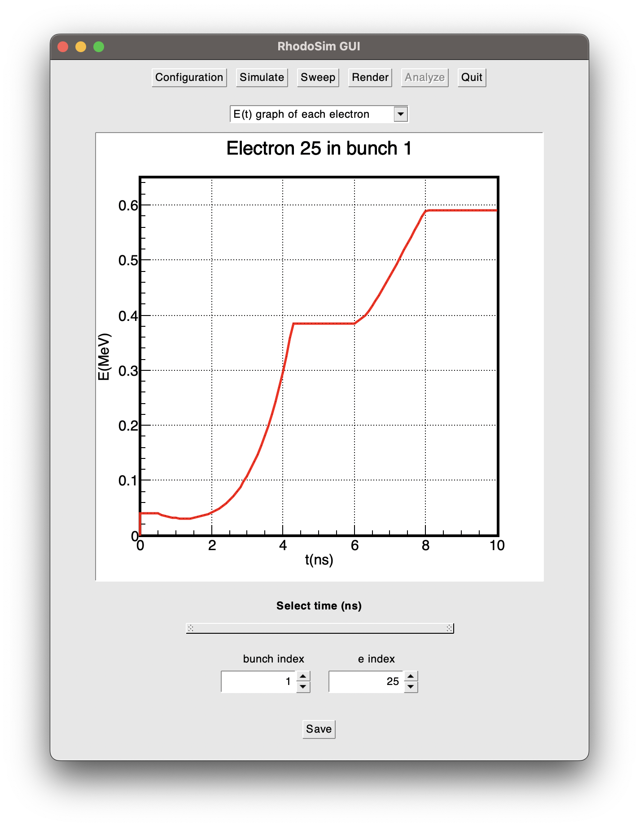
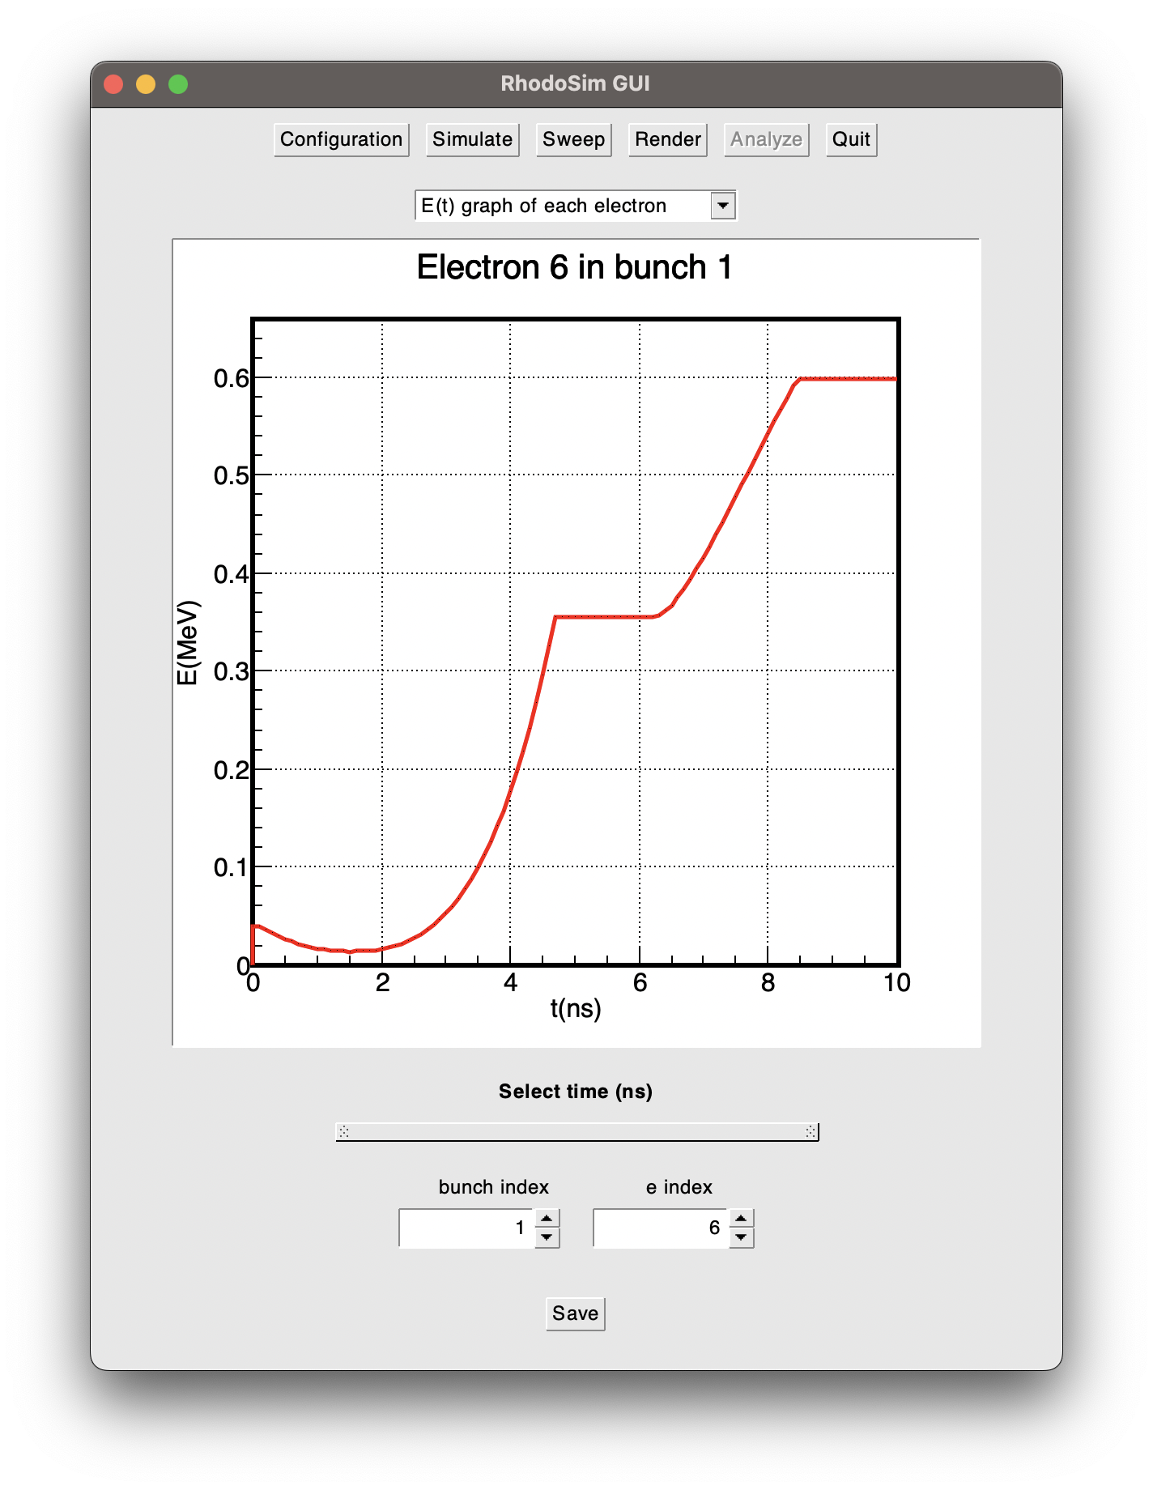
E(t) graphs
φlag = 16°
φlag = -48°
φlag = -59°

Slide 12
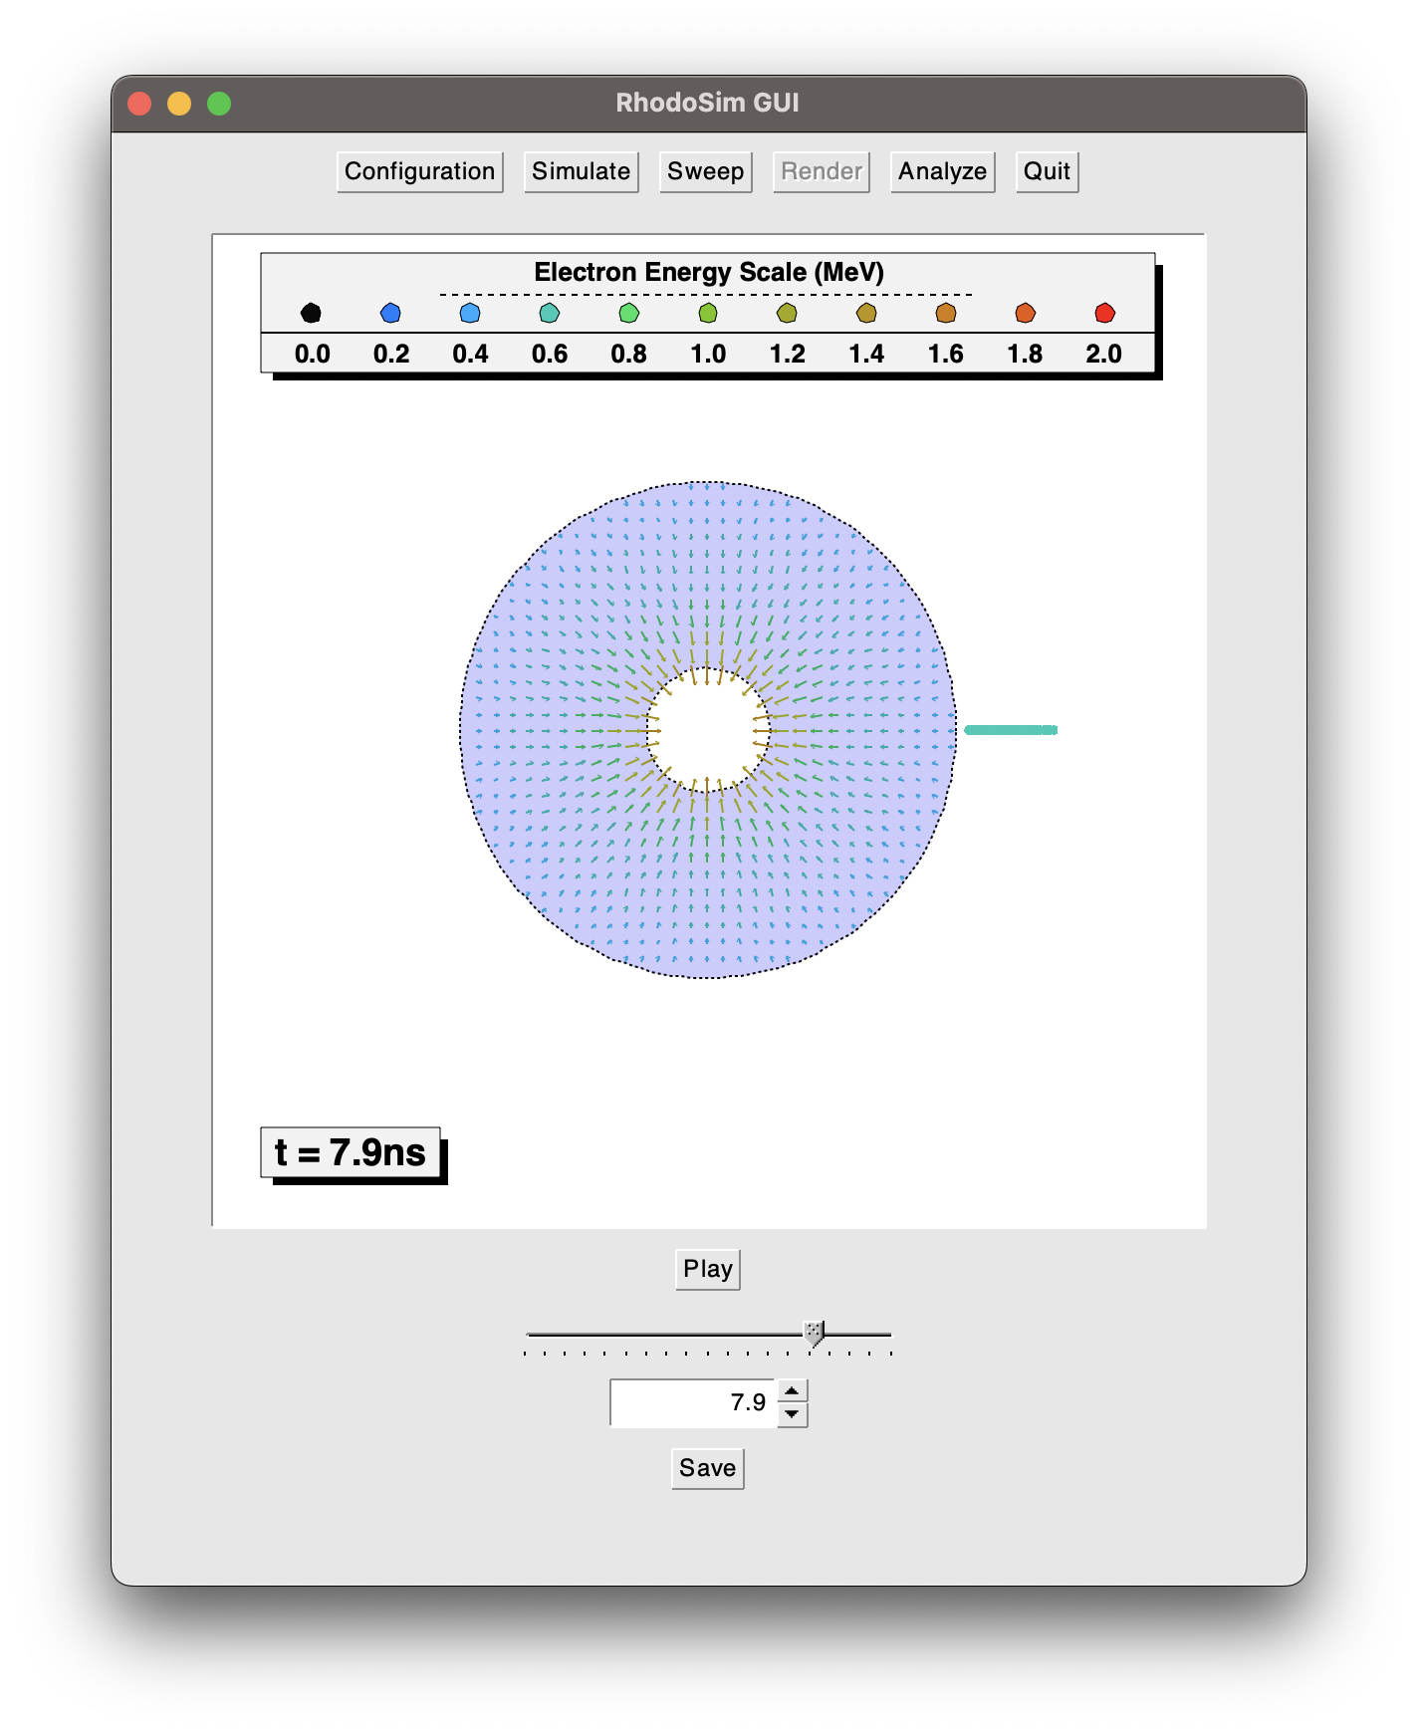
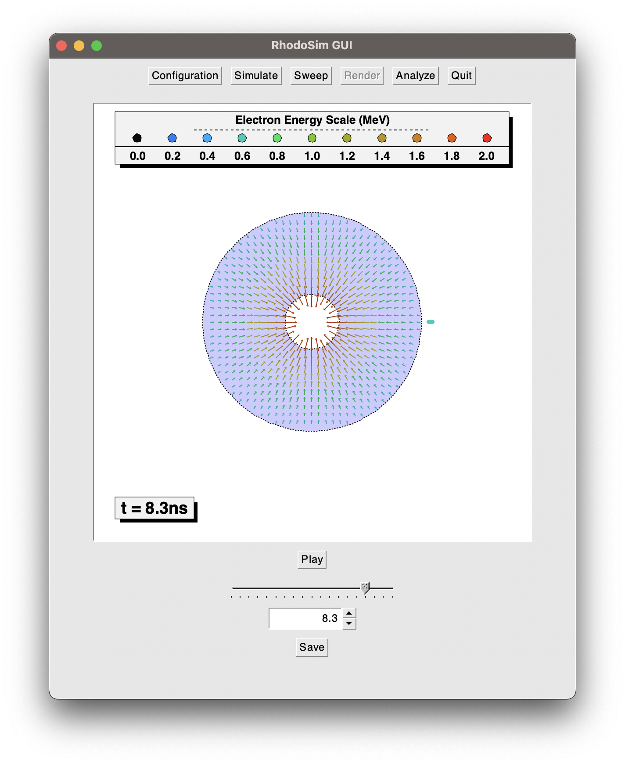

Renders
φlag = 16°
φlag = -48°
φlag = -59°

Slide 13
Optimum φlag
Depending on the application, any of these three can be selected:
φlag = 16° : Maximum decently uniform energy, beam spreads
φlag ≈ -48° : ~80% of energy gain of 16° but less uniform, very focused beam
φlag = -59° : ~80% of energy gain of 16° with similar uniformity, beam is focused
If we do not have a magnet and all we need is as much energy as we can with one cycle,
φlag = 16° is obvious choise.
If we have a low tolerance on the deviations from beamline (such as small radius of beam guides), applications with magnets needs to consider other alternatives.
φlag ≈ -48° provides lots of focusing but lower energy uniformity
φlag = -59° is best of both worlds, providing both decent focus and energy uniformity
Lets design a magnet for φlag = 16° and φlag = -59°

Slide 14
Rhodotron Simulation Workflow Example
We have produced a cavity:
R1 = 0.188 m
R2 = 0.753 m
f = 107.5 MHz
Our e-gun produces and injects electrons:
Ein = 40 keV
tg = 1 ns
Tg = 1/f = 9.3 ns
φlag = 16° & -59°
RF Power system forms a standing wave inside the cavity:
Emax(z=0) = 1.734 MV/m
f = 107.5 MHz
Electrons leave the cavity travels
r = ?
in the beam guide, entering a magnet with:
R = ?
B = ?

Slide 15
Rhodotron Simulation Workflow
Manifacture a rhodotron cavity
Setup the RF power system
Manifacture an electron injection system (e-gun)
Lout sweeps for magnets
Phase lag sweep
When should the e-gun work?

Slide 16
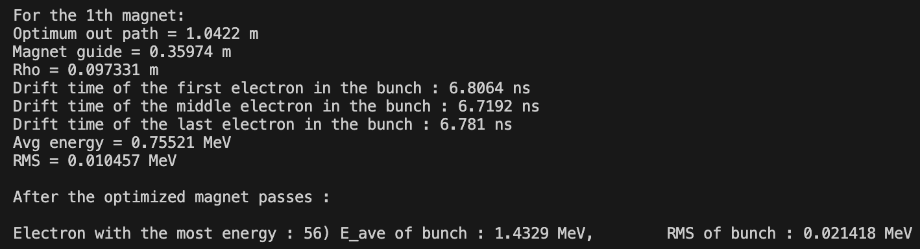
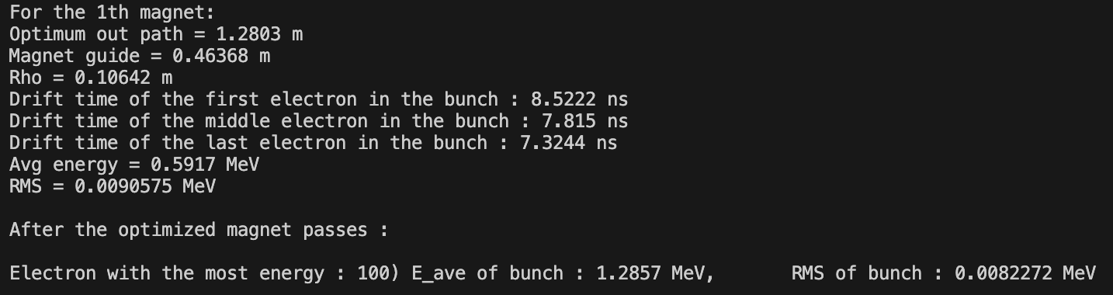
Lout Sweep Step 1:
Latest version does not support Lout sweep at the current stage, it is a work in progress. So use an older intermediate build in 1D ( not optimal )
For φlag = 16°:
r = L + R2 = 1.113 m
R > 0.1 m
B = -0.0397 z^ T
For φlag = -59°:
r = L + R2 = 1.217 m
R > 0.11 m
B = -0.0306 z^ T

Slide 17
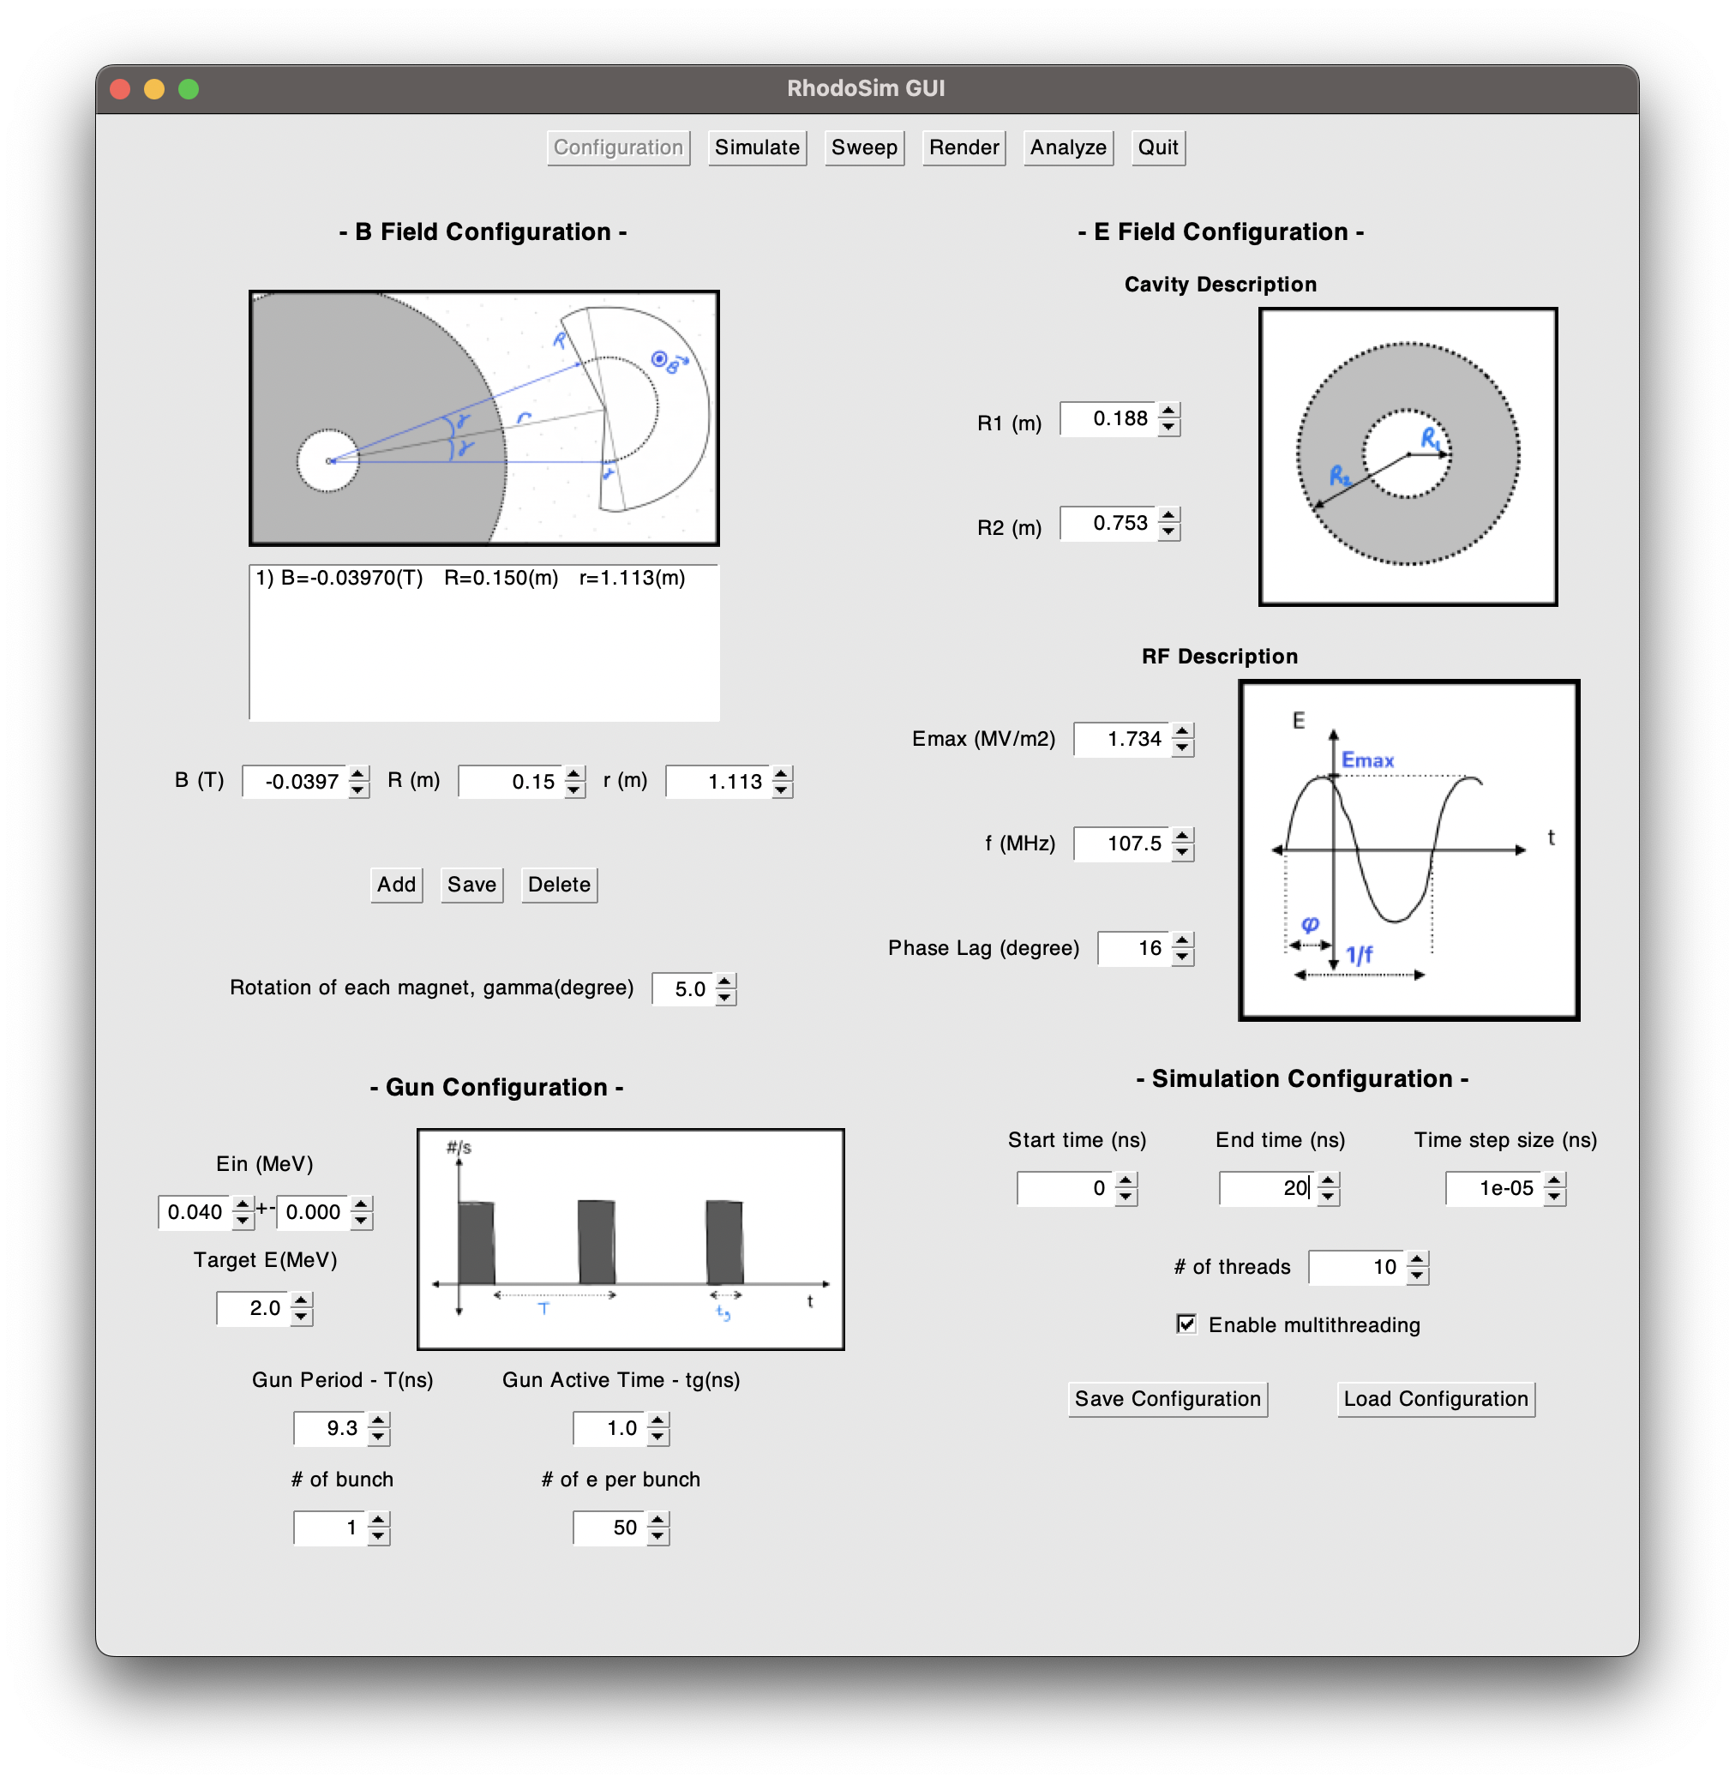

Lout Sweep Step 2:
Define the new magnets in Configuration Frame
φlag = 16°
φlag = -59°

Slide 18
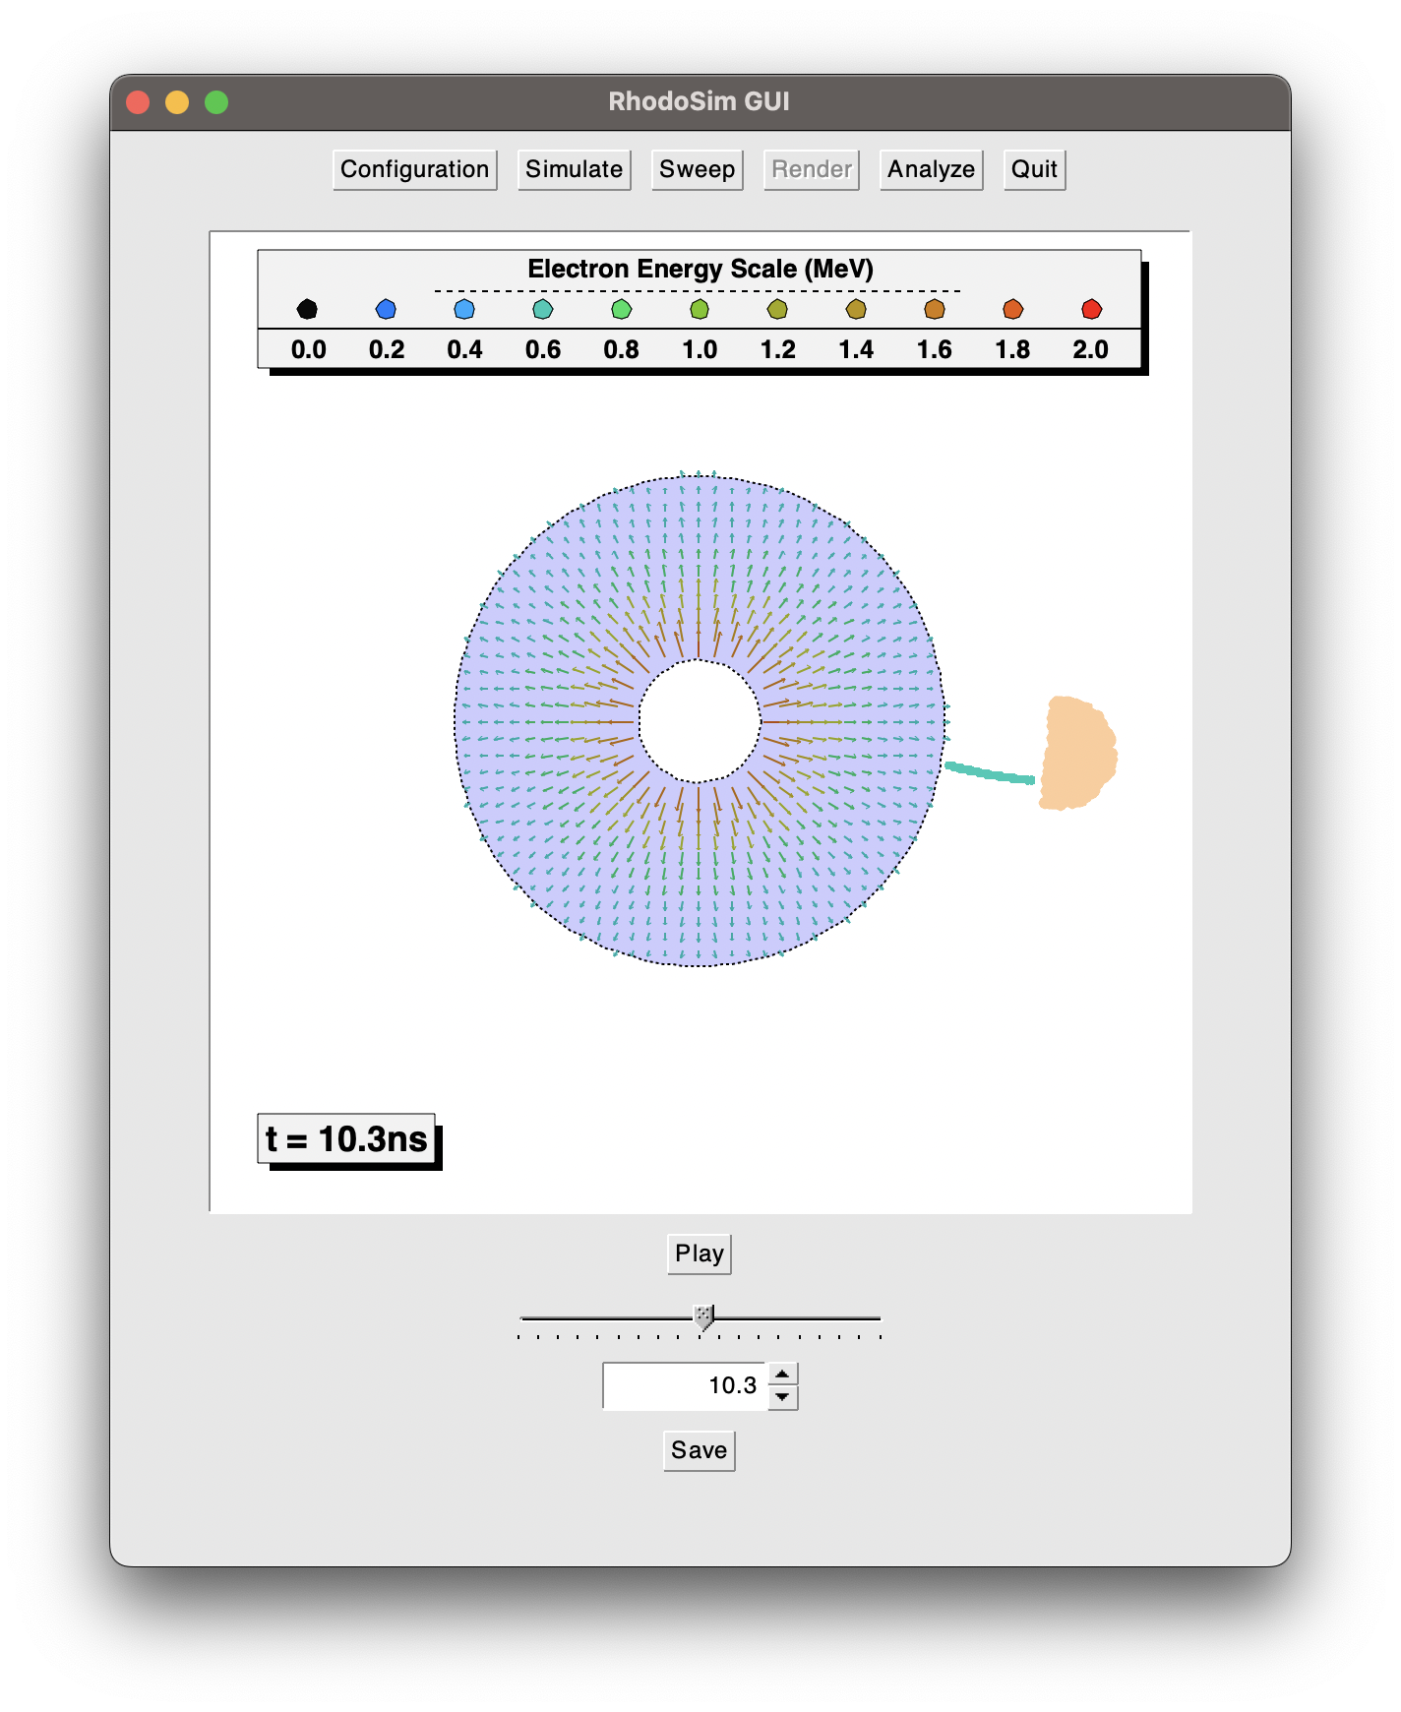
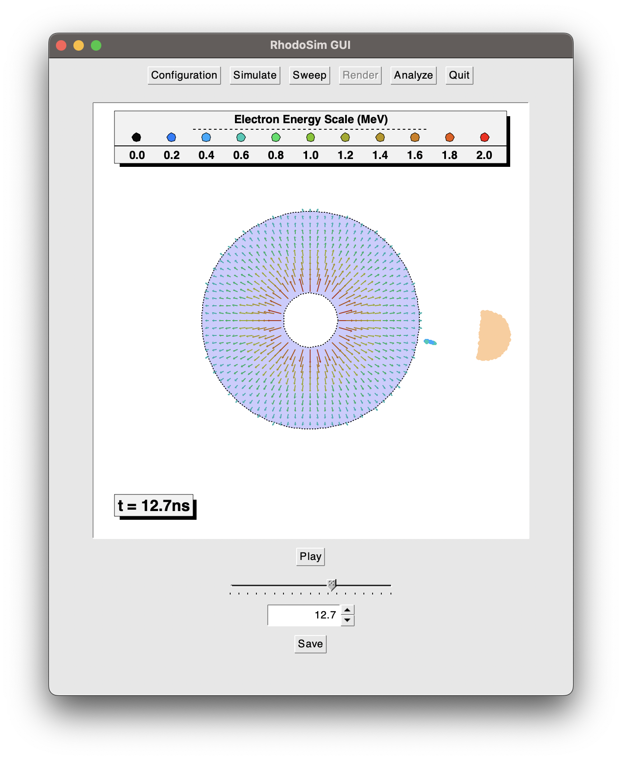
Lout Sweep Step 3:
Simulate in Simulation Frame
and Render & Analyze
φlag = 16°
φlag = -59°

Slide 19
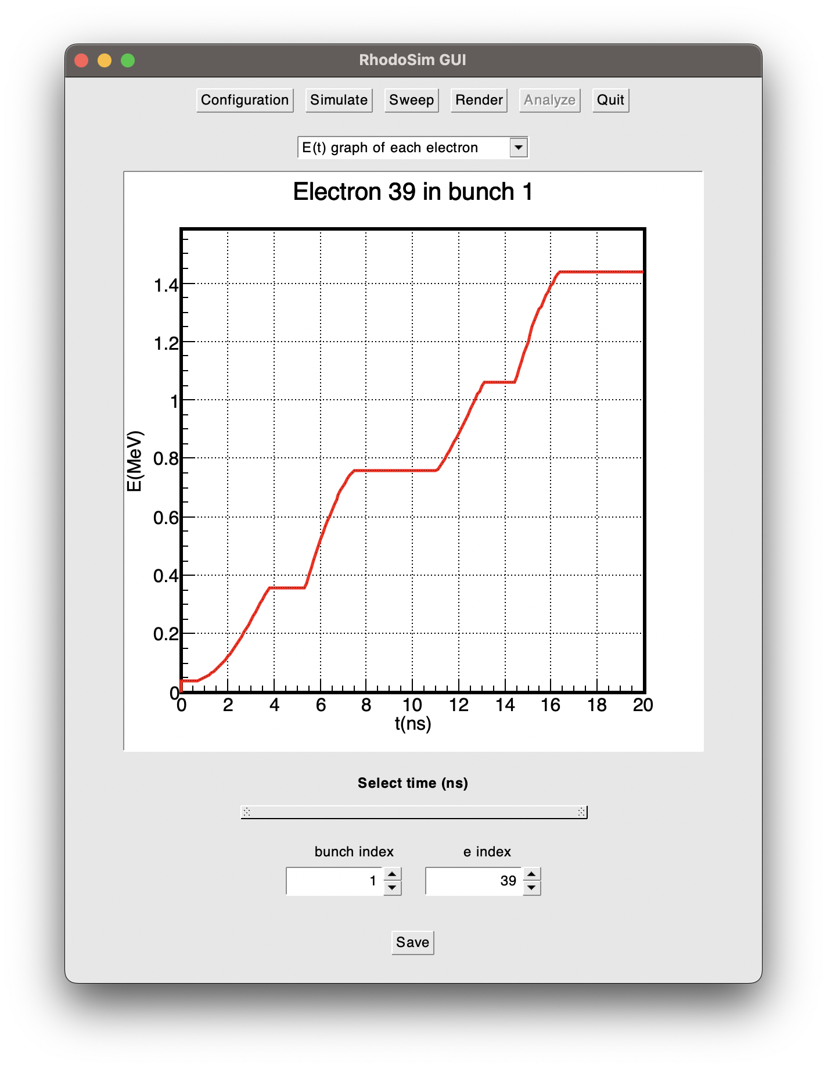
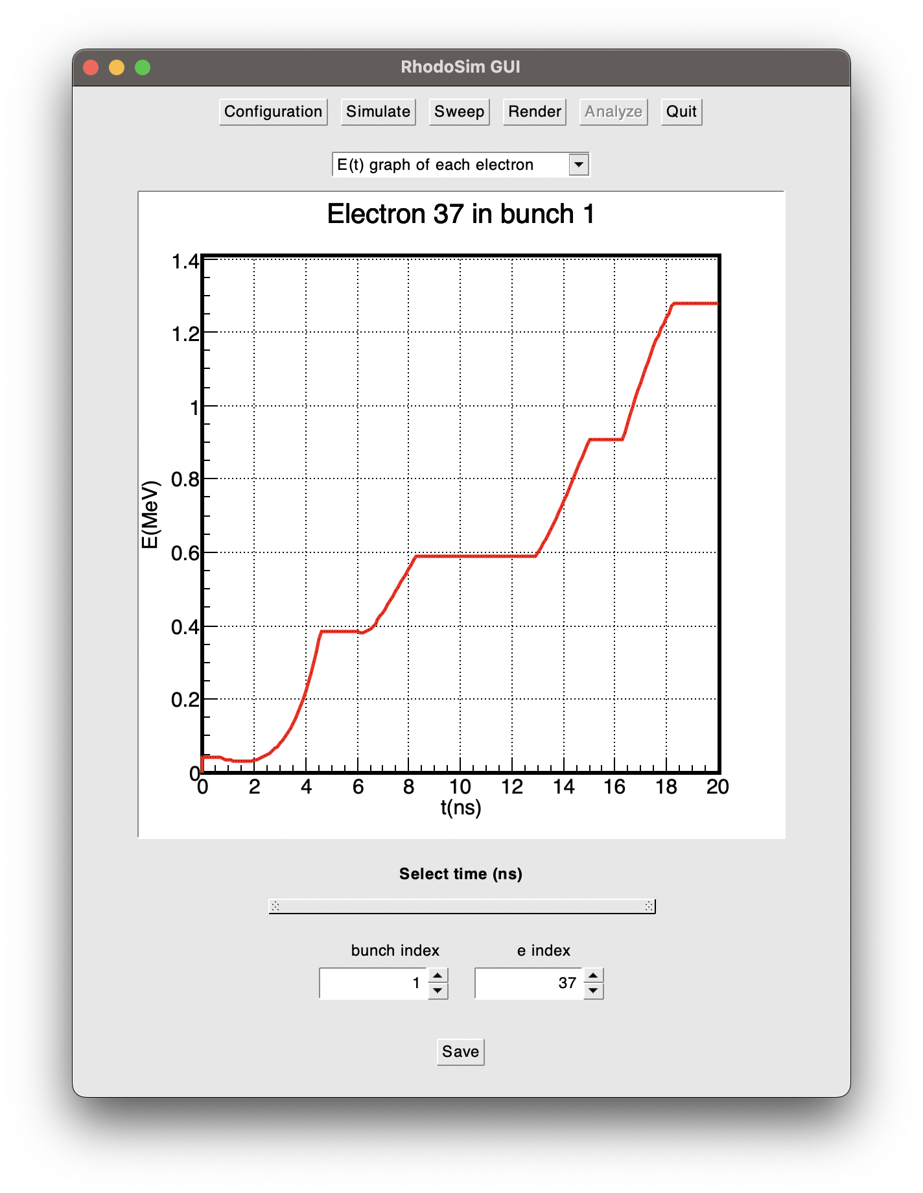
Lout Sweep Step 3:
φlag = 16°
φlag = -59°

Slide 20
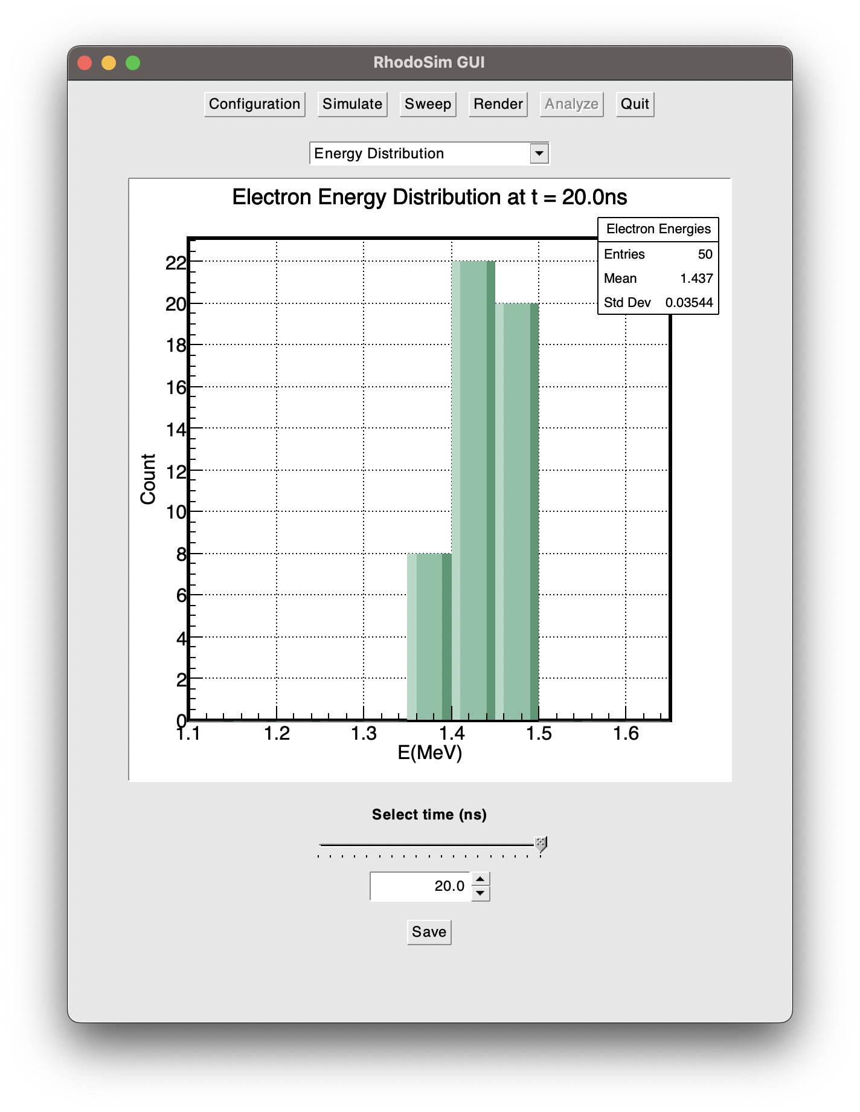
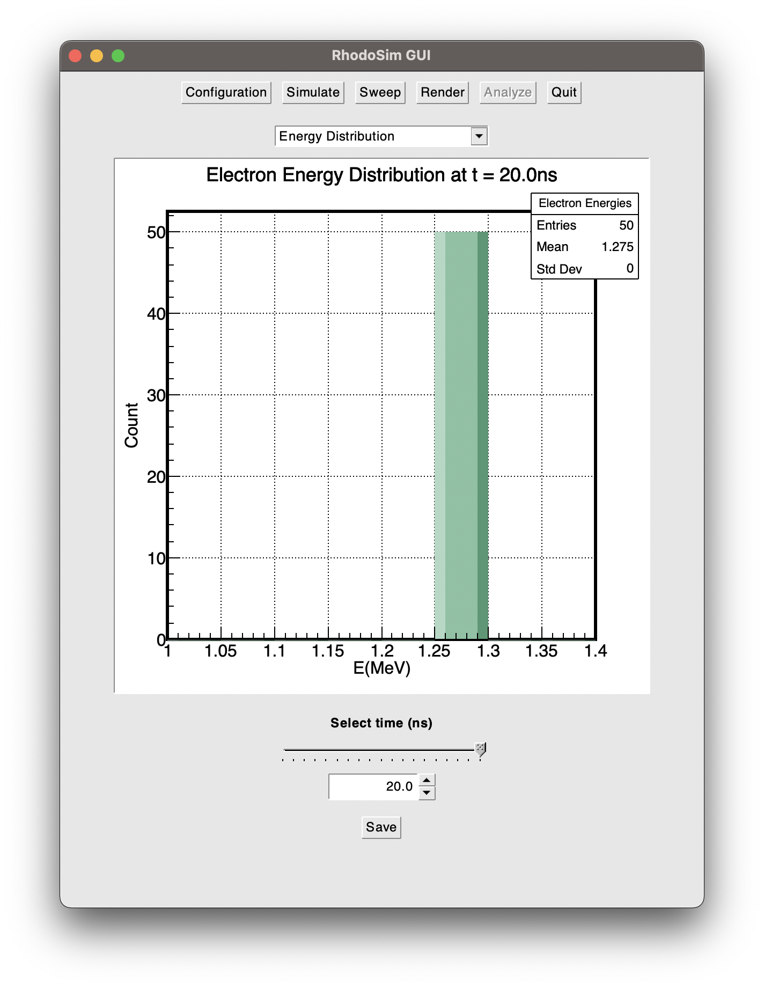
Lout Sweep Step 3:
φlag = 16°
φlag = -59°

Slide 21
Rhodotron Simulation Workflow
Manifacture a rhodotron cavity
Setup the RF power system
Manifacture an electron injection system (e-gun)
Lout sweeps for magnets
Phase lag sweep
When should the e-gun work?
Finished Design
Repeat for every magnet

